Slide 1

ACTIVE SHOOTER

Slide 2
Common Characteristics - Active Assailants
Containment and negotiation, normally associated with standoff incidents may not be useful
Often better armed than initial responding officers
May have planned attack to include sustained confrontation with police
Escape from police is usually not a priority
May employ some type of diversion
Notes:
PO #3
Containment and negotiation, normally associated with standoff incidents may not be useful
Often better armed than initial responding officers
May have planned attack to include sustained confrontation with police
Escape from police is usually not a priority
May employ some type of diversion

Slide 3
Common Characteristics - Active Assailants
Usually suicidal, either by self-inflicted wound or by “suicide by cop”
Some degree of familiarity with the location they choose for their attack
Event may turn from active to static and back again
May become barricaded subject if access to victims is stopped
Notes:
PO #3
Usually suicidal, either by self-inflicted wound or by “suicide by cop”
Some degree of familiarity with the location they choose for their attack
Event may turn from active to static and back again
May become barricaded subject if access to victims is stopped

Slide 4
What is NOT an Active Assailant
Barricaded Suspect/Hostage Taker
In a position of advantage, is armed, and has displayed violence
Suspect may or not be holding hostages and there is no indication that suspect is causing death or serious bodily injury. A STATIC SITUATION
Active Assailant deployment is NOT to be used in this situation or similar situations
Traditional response (perimeter negotiation)

Slide 5
Incident Command
In the case of an Active Shooter event, an Incident Command system will be setup in order:
Get officers needed to respond
Emergency Care
Control of movement
Communication between agencies involved
One point of contact in order to deal with situation
Notes:
PO #6
In the case of an Active Shooter event, an Incident Command system will be setup in order:
Get officers needed to respond
Emergency Care
Control of movement
Communication between agencies involved
One point of contact in order to deal with situation

Slide 6
HOSTAGE/BARRICADED SUBJECT
VS.
ACTIVE SHOOTER

Slide 7
ACTIVE SHOOTER RESPONSE Hostage/Barricade
One or more terrorists or criminals hold people against their will and try to hold off authorities by force, threatening to kill the hostages if provoked or attacked.
The 5 Cs:
Contain
Control
Communicate
Call SWAT
Create a Plan
Notes:
PO #5 / #4
One or more terrorists or criminals hold people against their will and try to hold off authorities by force, threatening to kill the hostages if provoked or attacked.
The 5 Cs:
Contain
Control
Communicate
Call SWAT
Create a Plan

Slide 8
ACTIVE SHOOTER RESPONSE ACTIVE SHOOTER
“One or more subjects who participate in a random or systematic shooting spree, demonstrating their intent to continuously harm others. An active shooter’s overriding objective appears to be that of mass murder, rather than criminal conduct such as robbery, kidnapping, etc.” - NTOA
Notes:
Po #2 / #4
“One or more subjects who participate in a random or systematic shooting spree, demonstrating their intent to continuously harm others. An active shooter’s overriding objective appears to be that of mass murder, rather than criminal conduct such as robbery, kidnapping, etc.” - NTOA

Slide 9
ACTIVE SHOOTER RESPONSE
Texas Tower – 1966 – resolved by patrol – created need for SWAT.
Columbine High School – 1999 – recognition that these events need to be resolved by patrol.
Beslan, Russia – 2004 – 49 Terrorists took over school. 314 hostages killed (186 children), 21 soldiers killed, 32 terrorists killed (17 escaped).
Mumbai – 2008 – 10 Terrorists gunned down 172 people over a 60 hour time span
Each incident has been taken into consideration in how we deal with and tactics involved in resolving situations.
Notes:
Po #1
Texas Tower – 1966 – resolved by patrol – created need for SWAT.
Columbine High School – 1999 – recognition that these events need to be resolved by patrol.
Beslan, Russia – 2004 – 49 Terrorists took over school. 314 hostages killed (186 children), 21 soldiers killed, 32 terrorists killed (17 escaped).
Mumbai – 2008 – 10 Terrorists gunned down 172 people over a 60 hour time span
Each incident has been taken into consideration in how we deal with and tactics involved in resolving situations.

Slide 10
ACTIVE SHOOTER RESPONSE Concepts & Principles
Stay Together
540 Cover/Security Around the Team
Communicate
Cover Angles
Threshold Evaluation (Slice the Pie)
Speed
Notes:
Stay Together
540 Cover/Security Around the Team
Communicate
Cover Angles
Threshold Evaluation (Slice the Pie)
Speed

Slide 11
ACTIVE SHOOTER RESPONSE Priority of Life Scale
Innocent Civilians
First Responders
Actors/Suspects
Property
Notes:
Innocent Civilians
First Responders
Actors/Suspects
Property

Slide 12
ACTIVE SHOOTER RESPONSE
Team Movement Techniques
Deliberate – slow/unknown location
Direct to Threat – known location
Notes:
PO #8
Team Movement Techniques
Deliberate – slow/unknown location
Direct to Threat – known location

Slide 13
ACTIVE SHOOTER RESPONSE Movement Techniques
Solo (extigent, no back-up, actionable intel)
2 (Tethered & Side by Side)
3 (Tethered & Side by Side)
4 (Diamond, T, Y, Box, Heavy Head)
5 (Special Skills/Double Rear Guard)
Notes:
PO #8
Solo (extigent, no back-up, actionable intel)
2 (Tethered & Side by Side)
3 (Tethered & Side by Side)
4 (Diamond, T, Y, Box, Heavy Head)
5 (Special Skills/Double Rear Guard)

Slide 14
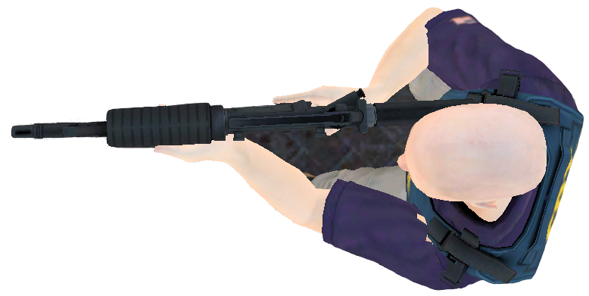
FORMATIONS - SOLO
Notes:
PO #8

Slide 15
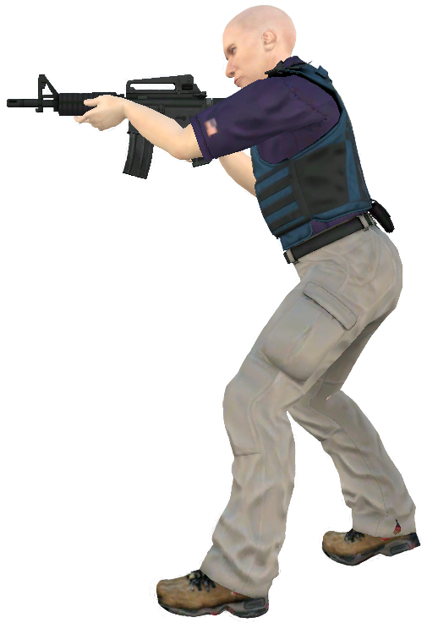
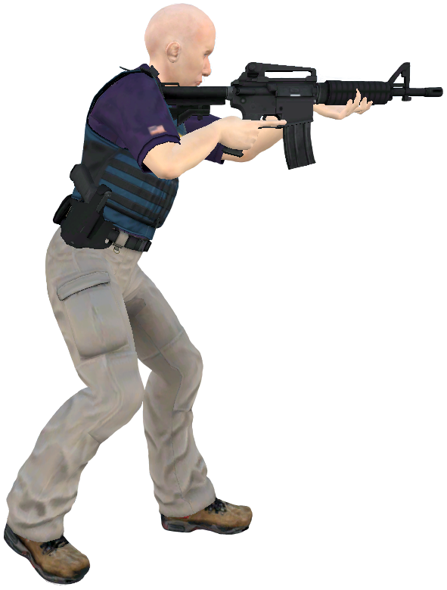
FORMATIONS – 2 MAN
SIDE X SIDE
TETHERED
Notes:
PO #8

Slide 16
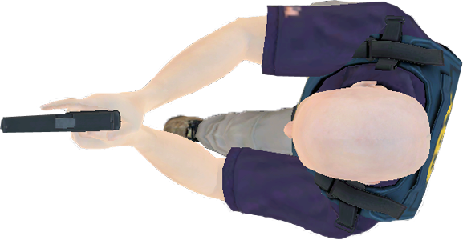
FORMATIONS – 3 MAN
SIDE X SIDE
TETHERED
Notes:
PO #8

Slide 17
FORMATIONS – 4 MAN
DIAMOND
T
Y

Slide 18
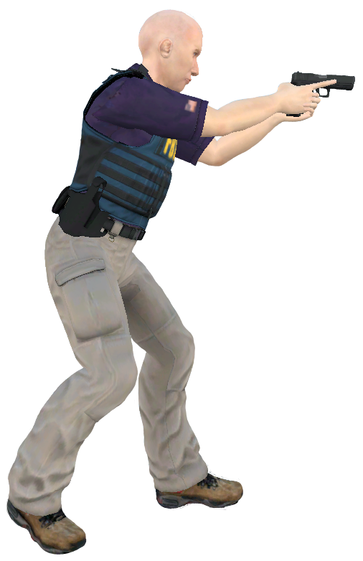
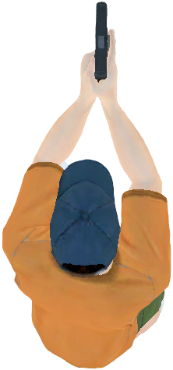
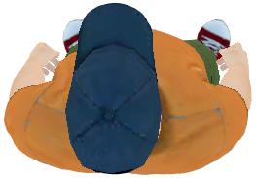
FORMATIONS – 4 MAN
BOX
FBI
FBI
FBI
FBI
HEAVY HEAD

Slide 19
FORMATIONS – 5 MAN
FBI
SPECIAL SKILLS
FBI
FBI
FBI
FBI
DOUBLE REAR GUARD

Slide 20
ACTIVE SHOOTER RESPONSE SIM
Security – Isolate, Distract & Neutralize Gunman.
Immediate Action Plan – Establish hallway security and follow-on plan.
Medical – identify, triage & treat injured
Notes:
PO #4
Security – Isolate, Distract & Neutralize Gunman.
Immediate Action Plan – Establish hallway security and follow-on plan.
Medical – identify, triage & treat injured

Slide 21
ACTIVE SHOOTER RESPONSE IEDS
“Bomb Cover” – appears that bomb thrown will stop 15’ or more from team
- seek cover, 90 degree offset/ create air gap
“Bomb Go” - when thrown device lands within 15’ of team
- move quickly past device and engage suspect throwing the device.
Notes:
Bomb Cover” – appears that bomb thrown will stop 15’ or more from team
- seek cover, 90 degree offset/ create air gap
“Bomb Go” - when thrown device lands within 15’ of team
- move quickly past device and engage suspect throwing the device.

Slide 22
ACTIVE SHOOTER TRAINING
Advanced Law Enforcement Rapid Response Tactics (ALERRT)
www.alerrt.com

