Slide 1
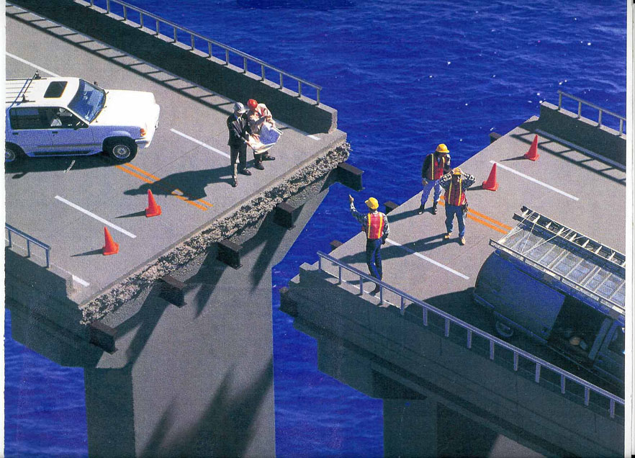
Communication Skills
Interpersonal Communication
2020 Pre-Service Training

Slide 2
Instructional Goal
The student will be able to effectively and efficiently communicate, both verbally and nonverbally , with the public, co-workers, supervisors and family members.

Slide 3
Performance Objectives
Upon Completion the student will be able to ….
Explain why understanding interpersonal communication is essential to effective policing
Define the dynamics of interpersonal communication to include:
1. Verbal communication
2. Nonverbal communication to include:
I. Paralanguage
II. Hearing vs. Listening
III. Nonverbal Behavior
IV. Proxemics

Slide 4
Performance Objectives (cont.)
C. Identify cultural considerations with regards to interpersonal communication to include:
1. Language
2. Culture
3. Ethnicity
4. Body Contact
D. Articulate the components of the IMPACT model of interpersonal communications

Slide 5
Performance Objectives (cont.)
E. Discuss the components of “effective citizen contact” to include:
1. CPR (courtesy, professionalism, and respect)
F. Effectively apply their interpersonal communication skills through various role playing scenarios

Slide 6
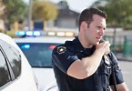
Communications and Policing
Effective communication gives an officer additional, alternative courses of action when responding to the many various calls for service that are encountered on a daily basis.
It really doesn't matter if the call for service is a simple complaint about the neighbor’s dog barking or a potentially violent call such as domestic violence.
Notes:
(PO# A)

Slide 7
Communications and Policing (cont.)
Understanding and being able to incorporate the dynamics of interpersonal communications can potentially diffuse many situations.
And as we all know, the public, media, courts and agencies are now, more than ever, holding officers more accountable for their actions.
Class Participation: Read/Discuss Handout #1
Notes:
(Introduction)
Consider the following scenario: An officer on patrol one afternoon observes a vehicle running a red light. The officer initiates a traffic stop and approaches the vehicle. As the officer is approaching the vehicle, he puts his hand on the butt of his holstered pistol. The driver of the car rolls down his window as the officer approaches. The officer leans down and glares at the driver and in a sarcastic tone of voice states, “If that light was any redder it would be dripping blood, what the hell were you thinking by running it?” “Give me your driver’s license, vehicle registration, and proof of insurance—NOW!” Problem solving goes hand in hand with law enforcement. In fact, the majority of your time as an officer will be spent trying to solve problems. Whether that problem solving involves face-to-face police-citizen contact, one-on-one or in small groups, your interpersonal communication skills are going to play a huge factor in how you are viewed as an officer. How you present yourself, both verbally and nonverbally, will determine the amount of respect, attitude, and cooperation that you will receive. Indirectly, your actions will also influence the public’s view of your department and law enforcement in general.
Interpersonal communications is designed to help you develop the skills needed for effective and efficient communication when dealing with the public. The skills that you develop from this course can be an additional tool in your chest of tools used on the job. In fact, this tool, when used correctly, can possibly eliminate the use of different tools on your duty belt.

Slide 8
Verbal Communication
The dictionary definition of verbal communication is “the use of sounds and words to express yourself, especially in contrast to using gestures or mannerisms (non-verbal communication).
Notes:
(PO# B1)

Slide 9
Verbal Communication (cont.)
Verbal communication is not only about “expressing” yourself and how those “expressions” affect the public you are dealing with, but as an officer, it is also about understanding the emotion and intentions behind the communication of those you are dealing with.

Slide 10
Verbal Communication (cont.)
Effective and efficient verbal communication is probably the number one asset, tool and quality of any law enforcement professional.
Communications skills that are effective enable the law enforcement officer to develop the needed rapport to not only deal with the public, but to, at times, disarm the criminals.

Slide 11
Verbal Communication (cont.)
Good communication skills may also enable the law enforcement officer to stay out of escalating situations that may result in serious injury or even death.
Class Participation: Read/Discuss Handout #2
Notes:
The goal of any contact with the public is to have conversations with people that lets them know their behavior is not acceptable, but yet, still holds them in some regard and communicates their worth and potential. In doing so, respect is created between the officer and the citizen. And respect is a “relationship” foundation that will either be viewed as positive or negative depending on the behaviors elicited by both the officer and the citizen.
Learning Activities/Decision Based Learning
Reread the scenario that was described at the beginning of this course. (Introduction)
Was this effective communication on the officer’s part?
Do you think the citizen viewed this contact as positive or negative?
Did the officer create any respect in this “relationship”?
How should the officer have verbally communicated?

Slide 12
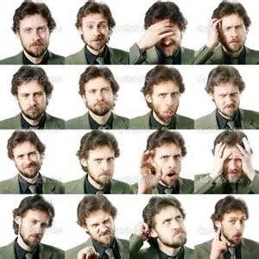
Nonverbal Communication
The dictionary definition of nonverbal communication is “communication by other means than by using words, e.g. through facial expressions, hand gestures, and tone of voice.”
Notes:
(PO# 2)

Slide 13
Nonverbal Communication (cont.)
Officers learn to “read people” by keying in on nonverbal communication cues that citizens exhibit. These cues, often times, can trigger an officer’s suspicion or curiosity on when a citizen is lying, getting ready to run, getting ready to attack or if they will be compliant and cooperative.

Slide 14
Nonverbal Communication (cont.)
On the same hand, officers need to realize that they too, exhibit nonverbal communication cues to the citizens.
The way citizens perceive officers nonverbal communication cues influences how they will react with the officer. In essence, an officers’ safety can be partly dependent on their ability to establish an “advantage” in any situation through their use of nonverbal cues.

Slide 15
Nonverbal Communication (cont.)
According to the Imprint Training Center, the use of verbal communication by an officer accounts for roughly 35% of an interaction between an officer and a citizen. But 65% of that same interaction is nonverbal communication.

Slide 16

In this next section of interpersonal communication, you will learn about various components of nonverbal communication. These components include paralanguage, hearing vs. listening, nonverbal behavior and proxemics.
Notes:
(PO# B 2I)

Slide 17
Paralanguage
Earlier we learned that verbal communication is the “use of sounds and words to express yourself”. Paralanguage is the “how” of the conveyed communication by using various speaking tempos, vocal pitch, and intonations.
Class Participation: Read/Discuss Handout #3
Notes:
Consider the following conversation between an officer and the driver of a traffic stop:
Officer: “Good morning sir. My name is Deputy Shasten, and I am with the City Police Department. Is there a reason you failed to stop at the stop sign on Oakwood and Lurth?”
Driver: “Really, I did not stop?”
Officer: “No sir, you did not even slow down.”
Driver: “Are you sure it was me, I think I did stop and maybe you are just tired and didn’t see me stop.”
Officer: “Sir, I just came on shift. I am sure you did not stop.”
Now, go back, and reread this conversation. Read it out loud and in a sincere manner. Now read the conversation again out loud, but this time say the last statement, by the officer, in a sarcastic manner. Did you notice that you changed your voice inflection, the rate at which you spoke, and the pitch of your voice when you said the statement? Just by changing paralanguage you can convey two different messages to the driver.
Each message will also be interpreted differently by the driver. In the first conversation, using a sincere manner, the driver will view the officer as calm and mature. The driver will be more likely to cooperate with the officer at this time. Conversely, if the driver detects tones of sarcasm from the officer, the driver will be more likely to become agitated and upset with the whole situation.
Paralinguistic clues are also very important for officers to recognize when listening to subjects. Not only do these clues reference the attitudes and behaviors of the subject, but they can indicate officer safety issues which are about to arise.

Slide 18
Hearing vs. Listening
“The most basic and powerful way to connect to another person is to listen. Just listen. Perhaps the most important thing we ever give each other is our attention.”
Rachel Naomi Remen
Notes:
(PO# B 2II)

Slide 19
Hearing vs. Listening (cont.)
Toastmasters International describes four levels of hearing and listening. Officers answering many calls in a day find it is very easy to fall into the first two levels without much effort at all.

Slide 20
Hearing vs. Listening (cont.)
However, to be a successful active listener you must work on focusing at the fourth level. It is at this level where you will find the most success in dealing with all types of situations. The levels are as follows:

Slide 21
Hearing vs. Listening (cont.)
Level I: Non-listener – is totally preoccupied with their own thoughts, could really care less about what is being said, and even though the words are being heard they are not being interpreted.
Level II: Passive listeners – hear the words, but there is no understanding or absorption of what is being said.

Slide 22
Hearing vs. Listening (cont.)
Level III: Listeners – try to pay attention to the speaker, but are only able to grasp some of the intended message.
Level IV: Active listeners – are completely focused on the speaker and can understand and interpret the full meaning of the words and nonverbal actions of the speaker.
Class Participation: Read/Discuss Handout #4
Notes:
“Did you hear me; I was not speeding past the hospital!” yelled an angry driver who had just been pulled over. As an officer, did you only hear the words of this subject or did you really focus on what the words meant and how they were said?

Slide 23
Hearing vs. Listening (cont.)
Active listening requires you to not only pay attention to what is being said, but it also means paying attention to “how” it was said. Hearing refers to the “hearing of the sounds”, whereas active listening not only requires you to “hear the sounds”, but to also focus on interpreting “what” you heard.

Slide 24
Hearing vs. Listening (cont.)
The tone, pitch, and rate of speech all need to be focused upon.
Active listeners are constantly interpreting the “what”, watching body language (of which we will cover later in the course), noticing inconsistencies between verbal and nonverbal messages, and what is being left unsaid or only partially said.

Slide 25
Hearing vs. Listening (cont.)
For example, if someone tells you they are ecstatic about a situation, yet have an angered look with tears swelling up in their eyes, they are most likely sending out conflicting verbal and nonverbal messages.
Being able to translate these messages can mean the difference between success and failure for the officer and the situation they are in.
Class Participation: Read/Discuss Handout #5
Notes:
(Read first part, then have students take turns reading numbered points)
According to the article, “Listening Skills”, posted on the Skillsyouneed.com website, there are “10 Principles of Listening”. Using these 10 principles will help you to be an effective and successful active listener.
Stop Talking – you need to focus and listen when somebody else is talking, don’t interrupt, talk while they talk, or try to finish their sentences for them (a common practice of controlling type personalities). Just listen. When they are done talking you can clarify what they said if need be.
Prepare to Listen – clear your mind of other thoughts, focus on the subject and the situation, concentrate on interpreting the message being communicated.
Put the Speaker at Ease – use nods or other gestures to encourage the subject to feel at ease, maintain eye contact to show you are interested and understanding the message.
Remove Distractions – don’t exhibit behaviors that disrupt the listening process, such as constantly looking away from the subject, shuffling papers, snapping/unsnapping for handcuff holder etc. All these behaviors tell your subject that you are really not interested in listening to them.
Empathize – put yourself in the subject’s place, imagine yourself being them. Don’t be judgmental, erase your preconceived ideas, and have an open mind.
Be Patient – let the subject speak their mind, sometimes this will take a long time, especially for someone in great stress. Never interrupt or try to finish the sentence for the subject with your thoughts.
Avoid Personal Prejudice – Don’t let the subject’s style of speech irritate and distract you from focusing. Everyone has different ways of speaking, some are shy, some are nervous, and some just can’t seem to get their points or feeling across.
Listen to the Tone – the volume, pitch and inflections being used can tell a lot about the subject and the situation they are in. Use this to your advantage in interpreting what the subject is trying to say.
Listen for Ideas, Not Just Words – depending on the situation it is not always easy to get the whole message from an aggravated or upset person. Listen for the bits and pieces that make up the whole picture.
10. Wait and Watch for Non-Verbal Communication – your eyes (as we will see in the nonverbal behavior section) play an important part by watching for additional information that is being transmitted via nonverbal behavior.

Slide 26
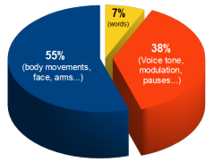
Nonverbal Behavior
According to an article entitled, “Body Language Speaks Volumes”, the author, Hope Boyd, states that 55% of the communication process is actually body language exhibited by the individuals involved in the communication.
Notes:
(PO# B2III)

Slide 27
Nonverbal Behavior (cont.)
An officer’s verbal communication may be viewed as encouraging, positive and/or authoritative. However, the officer’s nonverbal communication may be nullifying his/her verbal messages.
Officers are trained observers and over time become very wise and astute to the nonverbal behaviors of those they are dealing with.
The question is, are officers mindful of the nonverbal communication behaviors that they, themselves are projecting?
Class Participation: Read/Discuss Handout #6
Notes:
(After reading first part, have students take turns reading numbered points)
In an article by Justin Freeman, former police officer with the Springfield, Missouri police department, entitled, “5 things police officers should know about their body language”, he states that officers should ask themselves the following five questions:
1. Is my appearance a head start or a hurdle? We have all seen those officers that look less than professional in their uniforms. What tone does this appearance set when dealing with the public? Is it a tone of pride, organization, and discipline, or is it a tone of carelessness, non-readiness, or an attitude of “it’s just another job”?
2. Do I think the people I work with (and work for) are worth my time and effort? Officers answer many service calls a day, make traffic stops, and have to deal with a multitude of people who have many viewpoints, and attitudes. It can become a “hassle” at times. Officers need to be aware of the nonverbal behaviors that may intrude upon the verbal messages they are trying to exhibit. Impatience, looks of boredom, disbelief and rolling of the eyes are indicators to the public of what the officer’s demeanor is. If the public views the officer’s demeanor as less than positive, then the officer’s effectiveness has gone by the wayside.
3. What am I doing with my hands? An officer’s hands, whether moving or not, can be either a reinforcement to the verbal communication or can be viewed as very intimidating. The officer who, unknowingly, rests his hand on his gun, or other items on the duty belt, may actually be intimidating people while he talks. Nonverbal intimidation, however, does have its place in certain situations. But the officer needs to be cognizant of and in control of those behaviors.
4. What am I doing with my head and eyes? An officer’s head and eyes play a very important part in nonverbal communication. Consider the following scenario: Two officers respond to the local bar for a call of a bar room fight between two individuals. The officers separate the individuals, but because of the logistics of the bar they are unable to separate them to different rooms. The primary officer begins to talk to the first individual “A”, while still being able to see the second individual “B” standing with his back-up officer. While talking to the first individual “A” the primary officer consistently looks towards the other individual “B”. As the second individual “B” begins to yell things at the first individual “A”, the primary officer nods his head as if he is agreeing with the yelling individual “B”. What nonverbal message has the primary officer just sent to the first individual “A”? Do you think the first individual “A” might think that the primary officer is now agreeing with the second individual “B”? When the primary officer nods his head and keeps making eye contact with the second individual “B” he has now shut communication with the first individual “A”. The rapport he was hoping to build has been lost due to his unknowingly nonverbal behavior.
Am I conscious of my handshake? Our natural tendency when offered a hand to shake is to reach out and shake it. Thus conveying trust, respect, balance, and equality towards the other person. However, when in uniform, a handshake means much more. Some handshakes, such as those with business owners, other agency personnel and citizens at community functions, are every day, no problem, handshakes. But handshakes change drastically when you are dealing with people on a call for service. Officers should avoid handshakes on service calls until friend and foe can be sorted out. Handshakes show a sign of acceptance and can be very powerful in certain situations. Thus, it can be nonproductive to hand them out casually or without considering the message being sent.
Obviously, this is just a few of the nonverbal behaviors to be aware of. One could develop an exhausting list of all the different behaviors which are conveyed by officers during service calls.

Slide 28
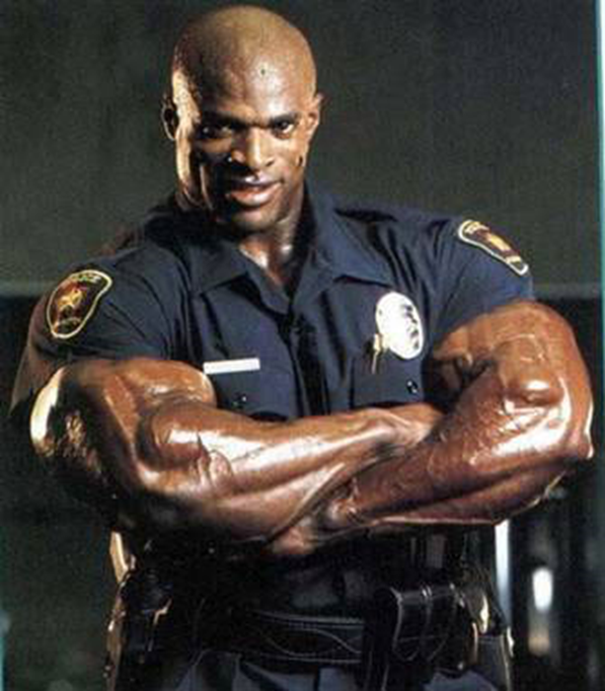
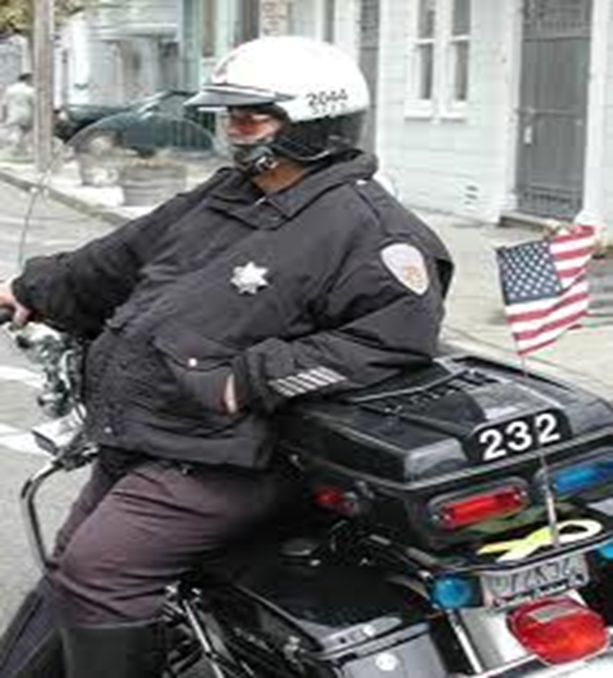
Which do You Want to Be?

Slide 29
Proxemics
Proxemics is the study of set measurable distances between people as they interact. In 1966, anthropologist Edward T. Hall introduced the term proxemics.
According to Hall, in his book, The Silent Language, there are four types of proxemics distances that people tend to use.
Keep in mind, however, that these distances can vary between culture.
Notes:
(PO# B2IV)

Slide 30


Proxemics (cont.)
The four types are intimate (0 – 18 inches), personal (18 inches – 4 feet), social (4 – 10 feet), and public (over 10 feet).
These distances that are deliberately chosen by the individual depend on their comfort levels and views of the situation at the time.

Slide 31
Proxemics (cont.)
It is crucial for law enforcement officers to be aware of proxemics in all situations.
Regardless, whether it is a service call, traffic stop, or everyday meeting of people, it is important to recognize how proxemics is going to affect the desired outcomes of the situation at hand.
Class Participation: Read/Discuss Handout #7
Notes:
Consider the following scenario: Officer Lingon, while dealing with a domestic situation where both individuals were being cooperative, determined the male subject was the primary aggressor. Because Officer Lingon let his emotions come into play, he felt that the male aggressor, before being handcuffed, needed to be lectured on appropriate treatment of women. Officer Lingon approached the male, put his finger up to the male’s face and began berating and sternly reprimanding the male. The male became agitated, angry and grabbed Lingon’s arm and ……. you can imagine what occurred from there.
In this scenario, did Officer Lingon need to enter the intimate space of the male? Did Officer Lingon’s actions serve to escalate the situation at hand? How should Officer Lingon have handled the situation?
Law enforcement officers should always recognize the safety factors of proxemics. Prior to the late 1980s, being close meant being in control of the situation for officers. This could not be further from the truth. In fact, the closer an officer is to a suspect the more dangerous the situation can become.

Slide 32
Proxemics (cont.)
Officers conducting field interviews (FIs) is a prime example of conscious proxemics.
Officers that fail to realize the importance of maintaining adequate distance between them and the subject being questioned are putting themselves in unnecessary danger.

Slide 33
Proxemics (cont.)
According to Dave Grossi in his article entitled, “The reactionary gap: Reminders on threats and distances”, the distance of safety for an officer is referred to as the reactionary gap. Grossi defines “police proxemics” as “the distance between an officer and the threat posed by certain weapons” (the reactionary gap).

Slide 34
Proxemics (cont.)
Grossi identifies the following distances as being the safety distances for officers:
Firearms: Generally, your safety zone is defined as “line of sight unbroken by cover”
Edged Weapons: Generally, a 20-25-foot zone of safety, depending on circumstances and the level of the officer’s response. That distance could be more if you have information that the suspect may be skilled with edged weapons.

Slide 35
Proxemics (cont.)
Impact Weapons: Bludgeons, pipes, baseball bats, and the like require a minimum reactionary gap of 10-12 feet plus the length of the object – maybe more depending on the circumstances.
Empty Hands: For most empty-hand situations, 5-6 feet, maybe more depending on prior knowledge of the subject.
Officers are constantly trying to stack the odds in their favor in everything they do. By awareness of and using proxemics officers can stack the odds just a little bit more.

Slide 36
Cultural Considerations
There is no arguing the fact that the United States has become a multinational country.
Today, every location in the country, whether urban, suburban, or rural, likely houses individuals from different cultures.
Therefore, law enforcement officers need to be skilled in recognizing how to communicate, both verbally and nonverbally, with the various cultures they may encounter.
Class Participation: Read/Discuss Handout #8
Notes:
(PO# C 1-3)
While different for each culture, the communication process is comprised of essentially three components – language, culture, and ethnicity.
These three components are the cultural foundations for its people’s self-concept, cognitive and coping skills.
As such, each culture has different “rules” for speaking and listening.
By being aware of the cultural rules, the officer is able to be sensitive and responsive to the expectations and restrictions governing the communication process of the culture.
The area of nonverbal communication that causes the most trouble with cross-cultural interaction is that of body contact.
Today’s society has cultures which view body contact differently. Officers need to be aware and sensitive to which cultures are body contact cultures and which are not.
Arabs, Southern Mediterranean, and Latin Americans are typical contact cultures.
In these cultures, physical closeness, occasional touching and frequent gesturing are important components of their communication process.
Conversely,
English and Northern European cultures interact with each other from greater distances that preclude physical contact.
Anglo-Americans usually fall in between the two, with most leaning towards non-contact interactions.
Law enforcement officers who understand the various communicative patterns of specific cultures can more accurately interpret the nonverbal cues being elicited by its members.
Learning Activities/Decision Based Learning
Discuss cultures and how law enforcement needs to recognize the importance of how to communicate with the community
Cultural nonverbal cues-the key to communication and interaction

Slide 37
Impact Model of Interpersonal Communication
Brian Fitch, lead subject matter expert for the IMPACT Project, a national consortium of law enforcement agencies and officials, developed the IMPACT model of interpersonal communications for law enforcement officers.
This model offers law enforcement officers an easy-to-follow formula for dealing with difficult people, soothing strong emotions, and managing conflict.
Notes:
(PO# D)

Slide 38
Impact Model of Interpersonal Communication (cont.)
The IMPACT model is built around six principles that can be applied to virtually any situational contact an officer has. The six principles are:
“I” Identify and Manage Emotions
“M” Master the story
“P” Promote Positive Behavior
“A” Achieve Rapport
“C” Control Your Response
“T” Take Perspective
Class Participation: Read/Discuss Handouts #9, #10, #11
Notes:
The order may and will probably vary, and each principle does not always stand by itself. And there will be times when more than one principle will occur at the same time. Each of the principles is a dynamic that is critical when dealing with difficult or angry people, managing conflict, and/or solving problems.
(PO# E1)
Learning Activity/Decision Based Learning
Discuss “effective citizen contacts”
Positive contacts
Negative contacts
Contacts that a third person may perceive (other citizens, media, witnesses, etc.)
Courtesy
Professionalism
Body conduct
Applying Interpersonal Communications (PO# F)
Learning Based Activities/Decision Based Learning
Have the class role play various communications scenarios

Slide 39
Effective Citizen Contact
The New York City Police Department states in its mission statement the following, “…by treating every citizen with courtesy, professionalism and respect…” These three words: courtesy, professionalism and respect, should represent the foundational principles for any contact that officers have.

Slide 40
Effective Citizen Contact(cont.)
Courtesy: polite behavior that shows respect for other people, patience, approachable, openness, and understanding.
Professionalism: skill, good judgement, and polite behavior that is expected of a law enforcement officer, nonjudgmental, accurate, honest, goes the extra mile, has tolerance.
Respect: paying attention, listening, empathy, caring, having humility.
Notes:
An easy way to remember this foundation is to realize that in any situation, whether it is a simple traffic stop or a crisis situation, in order for successful communication and the building of rapport there must be CPR (courtesy, professionalism and respect).
Law enforcement officers cannot avoid interactions with the public.
Whether it’s a traffic stop, criminal investigation, domestic violence or some other type of conflict, there will always be the need for effective interpersonal communication.
If officers cannot communicate with the public, poor community relations will hinder even the most technically proficient departments.
On the other hand, officers who are well trained and successful in interpersonal communications ensure themselves that they will communicate civilly and respectfully.
Ultimately leading to better public partnership.

Slide 41
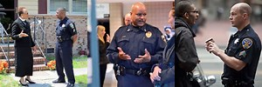
Effective Citizen Contact(cont.)
An easy way to remember this foundation is to realize that in any situation, whether it is a simple traffic stop or a crisis situation, in order for successful communication and the building of rapport there must be CPR (courtesy, professionalism and respect).

Slide 42
Effective Citizen Contact(cont.)
Law enforcement officers cannot avoid interactions with the public.
Whether it’s a traffic stop, criminal investigation, domestic violence or some other type of conflict, there will always be the need for effective interpersonal communication.
If officers cannot communicate with the public, poor community relations will hinder even the most technically proficient departments.

Slide 43
Effective Citizen Contact(cont.)
On the other hand, officers who are well trained and successful in interpersonal communications ensure themselves that they will communicate civilly and respectfully.
Ultimately leading to better public partnership.

Slide 44

Any Questions or Comments?

