Slide 1

WELCOME TO ETHICS IN LAW ENFORCEMENT
Notes:
Instructor should introduce themselves and give a brief background of their experience.

Slide 2
Goals and Objectives:
Refer to the POST Goals and Objectives
Notes:
Remind the class that a copy of the POST Goals and Objectives are provided in their handouts. This is also where the test questions are derived from.

Slide 3
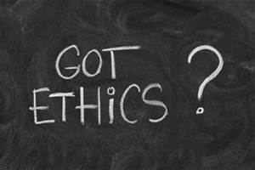
Definition of Ethics:
Ethics are a principle of right or good behavior - a guiding philosophy
Notes:
The science of morals; the department of study concerned with the principles of human duty.
The discipline dealing with what is good and bad and with moral duty and obligation.
The principles of conduct governing an individual or a group.
(Merriam-Webster)
THIS IS A TEST QUESTION

Slide 4
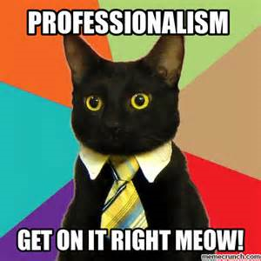
Definition of Professionalism:
Professional status
Your job title requires you to be professional
Methods
How you do your job reflects on how your are judged professionally
Character
Police officers are expected to have a professional character
Standards
You are required to live to the highest standards both on and off-duty.
Notes:
The public has high expectations of police officers. In this job, you are given authority to enforce the law. The public has placed that trust in you, but in exchange requires a high degree of professionalism.
Officers that enforce the law unfairly (excessive force, for example) make the entire department look bad. We all appear unprofessional in the eyes of the public.
Officers are expected to conduct themselves in a certain manner both on and off duty.
Class discussion on what they consider to be a professional officer.
THIS IS A TEST QUESTION

Slide 5
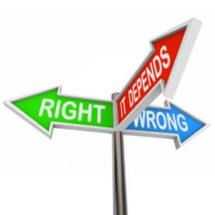
Definition of Morals:
In accordance with standards of what is right or just.
Notes:
Of, pertaining to, or concerned with the principles or rules of right conduct or the distinction between right or wrong.
Conforming to a standard of right behavior.
Capable of right and wrong action.
(Merriam-Webster)
THIS IS A TEST QUESTION

Slide 6
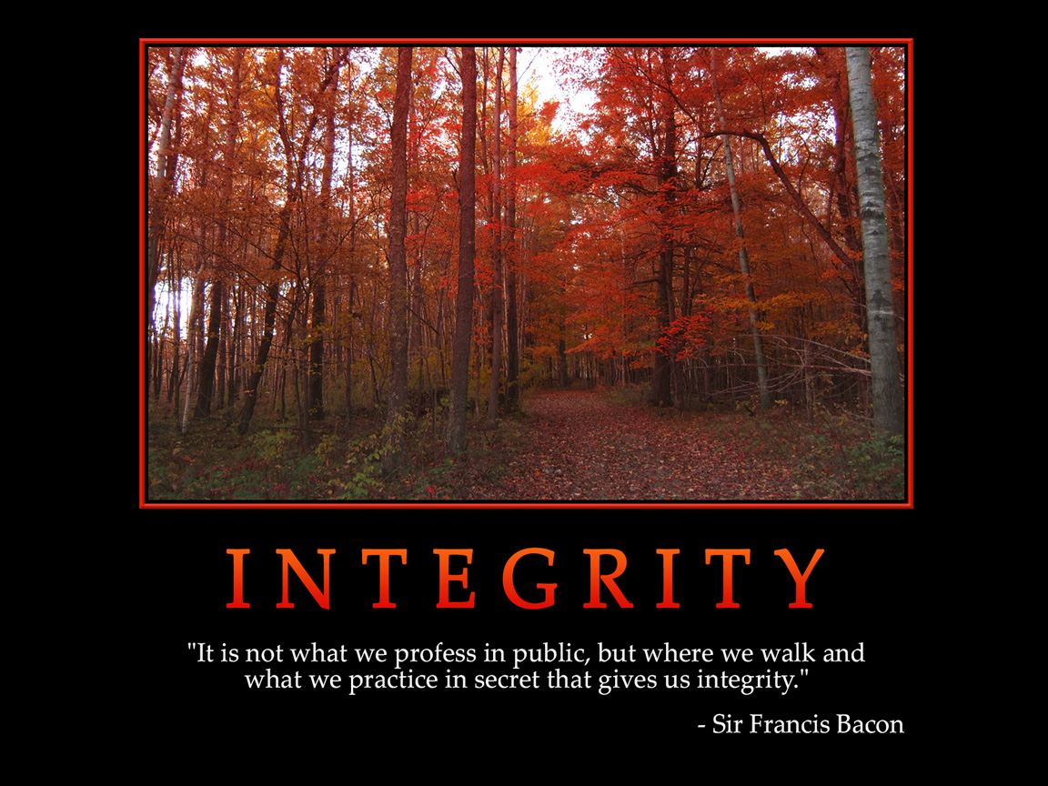
Definition of Integrity:
Firm adherence to a code or standard of values
Notes:
Adherence to moral and ethical principles; soundness of moral character; honesty.
A concept of actions, values, methods, measures, principles, expectations, and outcomes.
Incorruptibility!
THIS IS A TEST QUESTION

Slide 7
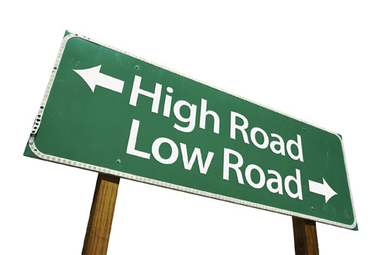
What do ethics mean to you?
Judgment
Moral Behavior
Values
Do not fear the truth!!! The truth is real, it is fact and it is never a lie. There is no remembering the truth, only stating the facts.

Slide 8
Nevada Department of Corrections Code Of Ethics
The Nevada Department of Corrections is committed to a code of ethics that will guide the performance, conduct and behavior of its employees. This code will ensure that our professionalism is reflected in the operation and activities of the Department and is recognized by all interested parties. In this light, the following principles are practiced:
▪ Employees shall maintain high standards of honesty, integrity, and impartiality, free from any personal considerations, favoritism or partisan demands.
▪ Employees shall be courteous, considerate, and prompt when dealing with the public, realizing that we serve the public.
▪ Employees shall maintain mutual respect and professional cooperation in their relationships with other staff members of the Department of Corrections.
▪ Employees shall be firm, fair, and consistent in the performance of their duties. Employees shall treat others with dignity, respect, and compassion and provide humane custody and care, void of all retribution, harassment or abuse.
Notes:
PO#5

Slide 9
Nevada Department of Corrections Code Of Ethics Cont…
▪ Employees shall uphold the tenets of the United States Constitution, its amendments, the Nevada Constitution, federal and State laws, rules and regulations, and policies of the Department.
▪ Whether on or off duty, in uniform or not, employees shall conduct themselves in a manner that will not bring discredit or embarrassment to the Department of Corrections and the State of Nevada.
▪ Employees shall report without reservation any corrupt or unethical behavior that could affect either inmates, employees, or the integrity of the Department of Corrections.
▪ Employees shall not use their position for personal gain.
▪ Employees shall maintain confidentiality of information that has been entrusted to them and designated as such.

Slide 10
Nevada Department of Corrections Code Of Ethics Cont…
▪ Employees shall not permit themselves to be placed under any kind of personal obligation that could lead any person to expect official favors.
▪ Employees shall not accept or solicit from anyone, either directly or indirectly, anything of economic value, such as a gift, gratuity, favor, entertainment, or loan which is, or may appear to be, designed to influence their official conduct.
▪ Employees will not discriminate against any inmate, employee or any member of the public on the basis of race, gender, creed, or national origin.
▪ Employees will not sexually harass or condone sexual harassment with or against any person.
▪ Employees shall maintain the highest standards of personal hygiene, grooming and neatness while on duty or otherwise representing the Department.

Slide 11

10 Deadly Ethical Sins
Lying
Alcohol/Drugs
Stealing Property
Stealing Time
Money
Cynicism
Domestic Violence
Inappropriate Sexual Conduct
Excessive Force
Text Messaging, E-Mail & Social Media

Slide 12
Canons of Police Ethics
Article 1 – Primary Job Responsibility
The primary responsibility of the police service, and of the individual officer, is the protection of the people of the United States through the upholding of their laws; chief among these is the Constitution of the United States and its amendments. The law enforcement officer always represents the whole of the community and its legally expressed will and is never the arm of any political party or clique.

Slide 13
Canons of Police Ethics
Article 2 – Limitations of Authority
The first duty of a law enforcement officer, as upholder of the law, is to know its bounds upon him in enforcing it. Because he represents the legal will of the community, be it local, state or federal, he must be aware of the limitations and proscriptions which the people, through law have placed upon him. He must recognize the genius of the American system of government which gives to no man, groups of men, or institution, absolute power, and he must insure that he, as a prime defender of that system, does not pervert its character.

Slide 14
Canons of Police Ethics
Article 3 – Duty to Be Familiar with the Law and with Responsibilities of Self and Other Public Officials
The law enforcement officer shall assiduously apply himself to the study of the principles of the laws which he is sworn to uphold. He win make certain of his responsibilities in the particulars of their enforcement, seeking aid from his superiors in matters of technicality or principle when these are not clear to him; he will make special effort to fully understand his relationship to other public officials, including other law enforcement agencies, particularly on matters of jurisdiction, both geographically and substantively.

Slide 15
Canons of Police Ethics
Article 4 – Utilization of Proper Means to Gain Proper Ends
The law enforcement officer shall be mindful of his responsibility to pay strict heed to the selection of means in discharging, the duties of his office. Violations of law or disregard for public safety and property on the part of an officer are intrinsically wrong; they are self-defeating in that they instill in the public mind a like disposition. The employment of illegal means, no matter how worthy the end, is certain to encourage disrespect for the law and its officers. If the law is to be honored, it must first be honored by those who enforce it.

Slide 16
Canons of Police Ethics
Article 5 – Cooperation with Public Officials in the Discharge of Authorized Duties
The law enforcement officer shall cooperate fully with other public officials in the discharge of authorized duties, regardless of party affiliation or personal prejudice. He shall be meticulous, however, in assuring himself of the propriety, under the law, of such actions and shall guard against the use of his office or person, whether knowingly or unknowingly, in any improper or illegal action. In any situation open to question, he shall seek authority from his superior officer, giving him a full report of the proposed service or action.

Slide 17
Canons of Police Ethics
Article 6 – Private Conduct
The law enforcement officer shall be mindful of his special identification by the public as an upholder of the law. Laxity of conduct or manner in private life, expressing either disrespect for the law or seeking to gain special privilege, cannot but reflect upon the police officer and the police service. The community and the service require that the law enforcement officer lead the life of a decent and honorable man. Following the career of a policeman gives no man special perquisites. It does give the satisfaction and pride of following and furthering an unbroken tradition of safeguarding the American republic. The officer who reflects upon this tradition will not degrade it. Rather, he will so conduct his private life that the public will regard him as an example of stability, fidelity, and morality.

Slide 18
Canons of Police Ethics
Article 7 – Conduct toward the Public
The law enforcement officer, mindful of his responsibility to the whole community, shall deal with individuals of the community in a manner calculated to instill respect for its laws and its police service. The law enforcement officer shall conduct his official life in a manner such as will inspire confidence and trust. Thus, he will be neither overbearing nor subservient, as no individual citizen has an obligation to stand in awe of him nor a right to command him. The officer will give service where he can, and require compliance with the law. He will do neither from personal preference or prejudice but rather as a duly appointed officer of the law discharging his sworn obligation.

Slide 19
Canons of Police Ethics
Article 8 – Conduct in Arresting and Dealing with Law Violators
The law enforcement officer shall use his powers of arrest strictly in accordance with the law and with due regard to the rights of the citizen concerned. His office gives him no right to prosecute the violator nor to mete out punishment for the offense. He shall, at all times, have a clear appreciation of his responsibilities and limitations regarding detention of the violator; he shall conduct himself in such a manner as will minimize the possibility of having to use force. To this end he shall cultivate a dedication to the service of the people and the equitable upholding of their laws whether in the handling of law violators or in dealing with the law-abiding.

Slide 20
Canons of Police Ethics
Article 9 – Gifts and Favors
The law enforcement officer, representing government, bears the heavy responsibility of maintaining, in his own conduct, the honor and integrity of all government institutions. He shall, therefore, guard against placing himself in a position in which any person can expect special consideration or in which the public can reasonably assume that special consideration is being given. Thus, he should be firm in refusing gifts, favors, or gratuities, large or small, which can, in the public mind, be interpreted as capable of influencing his judgment in the discharge of his duties.

Slide 21
Canons of Police Ethics
Article 10 – Presentation of Evidence
The law enforcement officer shall be concerned equally in the prosecution of the wrong-doer and the defense of the innocent. He shall ascertain what constitutes evidence and shall present such evidence impartially and without malice. In so doing, he will ignore social, political, and all other distinctions among the persons involved, strengthening the tradition of the reliability and integrity of an officer's word.
The law enforcement officer shall take special pains to increase his perception and skill of observation, mindful that in many situations his is the sole impartial testimony to the facts of a case.

Slide 22
Canons of Police Ethics
Article 11 – Attitude toward Profession
The law enforcement officer shall regard the discharge of his duties as a public trust and recognize his responsibility as a public servant. By diligent study and sincere attention to self-improvement he shall strive to make the best possible application of science to the solution of crime and, in the field of human relationships, strive for effective leadership and public influence in matters affecting public safety. He shall appreciate the importance and responsibility of his office, and hold police work to be an honorable profession rendering valuable service to his community and his country.

Slide 23
The Six Pillars of Character
Trustworthiness- honesty, integrity, promise keeping, loyalty and fortitude
Respect
Responsibility- accountability, pursuit of excellence and self restraint
Justice and Fairness
Caring
Civil Virtue and Citizenship

Slide 24

Ethical Dilemma:
A situation in which the individual:
Does not know the right course of action
Has a difficult time doing what they know is right
Finds the wrong choice very tempting
Categories:
Discretion (legality)
Duty (service)
Honesty
Loyalty
Gratuities and/or Bribes
Notes:
Class discussion – What are some examples of gratuities and bribes that officers routinely face?
Free coffee
Free meals
THIS IS A TEST QUESTION
How can these affect our ability to objectively do our job? How does the public view it when they see an officer getting something for free?

Slide 25
Causes of Unethical Behavior
Attitude– the professional’s most valuable asset.
Anger– a major cause of unethical behavior within law enforcement.
Lust- next to hunger and thirst, lust is the most powerful human drive.
Greed- flourishes throughout American society.
Stress- under stress, people normally react the way they have been trained.
Peer Pressure- no matter your age, it has a tremendous influence on behavior.
Selfishness- “It’s all about me”

Slide 26
Result of unethical behavior
The public expects law enforcement to use their authority without malice or improprieties.
Failure in this area means that the citizens will strive to remove or limit that authority
Notes:
If police abuse their authority, new legal precedents can be set by court cases and new laws can be created legislatively that will remove or limit police authority.
Example: Over-use of tasers have resulted in new cases limiting when it is appropriate to use a Taser.
THIS IS A TEST QUESTION

Slide 27
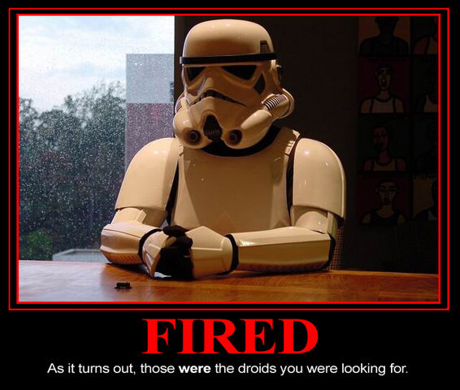
Statistics show that we lose 3-4 times more officers each year to misconduct vs. death.

Slide 28
Ask Yourself……..
Do I recognize who I am, what my personal code of ethics is and where it came from?
Can I submit to the Department’s code of ethics without compromising the values and morals that I have adopted?
Can I do the right thing, for the right reasons, each and every day?
Am I prepared to face the ethical dilemmas and barriers that law enforcement officers encounter during their careers?

Slide 29
Conducting Misconduct Investigations
Why do we conduct investigations???
Community trust
Maintain integrity
Transparency
Police the Police
To protect our personnel, our Department, and the public
Notes:
We have no “legal” obligation to conduct an investigation.

Slide 30
Investigations continued:
What happens if we don’t investigate complaints???
Loss of public trust
Allegations of corruption
“Sweeping things under the rug”
“Good old boys club”
Taint the “Thin Blue Line”

Slide 31
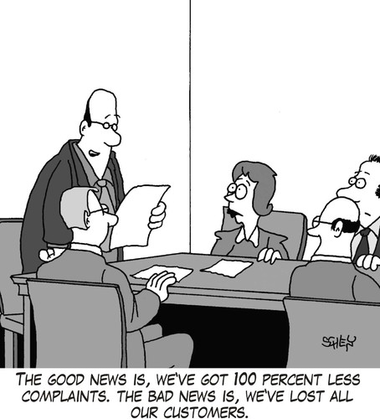
Types of Complaints:
Oral
Written
Internal
Anonymous
3rd Party
Notes:
PO#14

Slide 32
Investigative Process
Peace Officer’s Bill of Rights NRS 289
The officer’s testimony is compelled, but cannot be used against him criminally
(Garrity v. New Jersey, 385 U.S. 493) NAC 284
Burden of proof is a preponderance of evidence.
Notes:
NRS 289 is provided in the handouts PO#12, 15

Slide 33
Gratuities & Gifts
It is hard to ignore the subject of gratuities in any class on peace officer ethics.
Many articles appearing in law enforcement publications and academic journals discuss the topic, and civilians often identify it as an enduring problem among peace officers.
Still, many officers believe there is nothing wrong with accepting gratuities.

Slide 34
One distinction that can be made in these dilemmas is between:
True gratuities, something given to any officer as a matter of policy, and
Gifts, something given to an individual in return for a specific action.
However, both gratuities and gifts can become problematic issues for officers and agencies.

Slide 35
Gratuities & Gifts Dilemmas
Declining a Gratuity:
To avoid any suggestion of impropriety, you prefer to pay for drinks and meals at area establishments. You have learned from experience that people always expect something in return.
You stop by a convenience store for a soda. The clerk refuses to accept payment. You explain that you would prefer to pay.
The clerk, now upset, accuses you of trying to be better than the other officers. He threatens to tell your supervisor, who also stops by occasionally. What do you do?

Slide 36
The circumstances amid which you live determine your reputation; the truth you believe determines your character.
Reputation is what you are supposed to be; character is what you are.
Reputation is the photograph; character is the face.
Reputation comes over one from without; character grows up from within.

Slide 37
Ethics
Doing the right thing even when no one is watching you

Slide 38
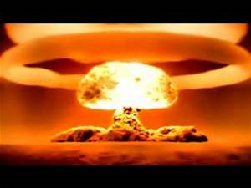
Conclusion
Everything we do is up for scrutiny
There are cameras everywhere and it is legal to record our behavior
Do not jeopardize your career due to a momentary lapse of integrity, morals, ethics, or immoral or unethical behavior!!

