Slide 1
Crime Scenes/Evidence collection and preservation
Introduction:
Crime scene investigation in the meeting point of science
logic and law. “Processing a crime scene” is a long, tedious
process that involves purposeful documentation of the
conditions at the scene and the collection of any physical
evidence that could possibly illuminate what happened and
point to who did it
Notes:
There is no typical crime scene, there is no typical body of evidence and there is no typical investigation approach.

Slide 2
Investigations of Crime Scenes
What is a Crime Scene?
-A crime scene is a location where a crime took place.
What is Evidence?
-Evidence, broadly construed, is anything presented ln support of an assertion.
Notes:
(PO#A1) =A crime scene is a location where a crime look place (or another location where evidence of the crime may be found), and comprises the area from which most of the physical evidence is retrieved by law enforcement personnel, crime scene investigators (CSls) or in rare circumstances, forensic scientists. Crime scenes may or may not be where the crime was committed.
(PO#A2)= Evidence, broadly construed, is anything presented ln support of an assertion. This Support may be strong or weak. The strongest type of evidence is that which provides direct proof of the truth of an assertion. At the other extreme is evidence that is merely consistent with an assertion but does not rule out other, contradictory assertions, as in circumstantial evidence.
Assertion means=a confident and forceful statement of fact or belief.

Slide 3
Investigations of Crime Scenes
Conducting the Initial Survey of a Crime Scene.
-Ask yourself these questions
1. Is the scene safe to enter?
2. Does the scene contain a person who may need medical assistance?
3. Do any hazards exist to emergency responders?
4. Is a search warrant needed?
Notes:
(PO#B 1) When making an initial observation of a scene, is it a crime? If so remember, the best search option are typically the most time consuming. You can never over document the physical evidence. The initial search is the one chance to perform the search correctly.

Slide 4
Investigations of Crime Scenes
Conducting the Initial Survey of a Crime Scene.
- Precautions at the Scene.
1. Approach the scene safely.
-First Priority
2. Be aware of discarded items that may be evidence. -Weapons, hazardous materials,
3. Always secure and protect entry to the scene.
-atmospheric and or Dangerous persons
4. Are you going to need assistance.
-Notify Supervisory Personnel
Notes:
Once you have answered your initial concerns, you will start to make a plan on how you will start to conduct the crime scene.
The safety and physical well-being of officers and other individuals, in and around the crime scene, are the initial responding officer(s) first priority. The responding officer(s) should:
Approach the scene in a manner designed to reduce risk of harm to officer while
maximizing the safety of victims, witnesses, and others in the area.
Survey the scene for dangerous persons and control the situation.
Notify supervisory personnel and call for assistance/backup.

Slide 5
Investigations of Crime Scenes
Conducting a Crime Scene Search.
1. Prepare a narrative description.
2. Make notes-for your written report later.
3. What are you observing.
4. Contacts-people interviewed/arrested.
5. Evidence found and recovered-Tagged(time and location), packaged, photographed, all items listed on a property page.
Notes:
(PO#B 2) Make sure you have the correct equipment and supplies to process the crime scene. Start with the plan you have made to conduct the search. Documentation of a crime scene is extremely important. Do not touch, move or alter any evidentiary item until you document the scene.

Slide 6
Photographing Crime Scenes
Photographs allow a visual permanent record of the crime scene and items of evidence collected .
Notes:
(PO3B 3) Photographs should be taken as soon as possible, to depict the scene as it is observed before anything is handled, moved, or initiated into the scene. The photographs allow a visual permanent record of the crime scene and items of evidence collected from the crime scene,

Slide 7
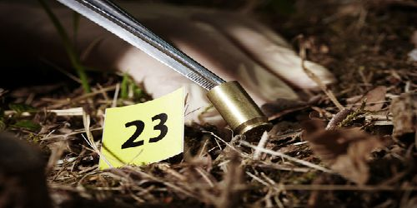
Photographing Crime Scenes
Taking crime scene photographs:
- Photographs should be taken as soon as possible.
- Three Positions or views:
-Overall scene.
-Mid-range photographs.
-Close up.
Notes:
(PO3B 3) Photographs should be taken as soon as possible, to depict the scene as it is observed before anything is handled, moved, or initiated into the scene. The photographs allow a visual permanent record of the crime scene and items of evidence collected from the crime scene,
- There are three positions or views that the crime scene investigator needs to achieve with the photographs. Those views consist of overall scene photographs showing the most view possible of the scene, mid-range photographs showing the relationships of items and a close up of the item of evidence. A close up should be taken of items that have serial numbers, tags and vin's.

Slide 8
Photographing Crime Scenes
Photographs start to finish:
1. Photograph entire area before it is entered.
2. Photograph victims, crowds, and vehicles.
3. Photograph entire scene with Overall, Medium, and close-up coverage, Using measurement scale when appropriate.
Notes:
(PO3B 3) A second photograph adding a measuring devise should be taken of items where the photo will assist in the analytical process.

Slide 9
Photographing Crime Scenes
Photographs start to finish:
4. Photograph major evidence items before they are moved.
5. Photograph all latent fingerprints and other impression evidence before lifting and casting are accomplished.
6. Prepare photographic log and photographic sketch.
Notes:
(PO3B 3) Photograph major evidence items before they are moved

Slide 10
Crime Scene Diagram.
Notes:
(PO#B 3i) Prepare a diagram/sketch of the scene.
1. A diagram establishes a permanent record of; items, conditions and distance/size relationships. Diagrams supplement photographs and videos.
2. A rough sketch is drawn at the scene and changes are not made once you-have left the scene.
Sketches should contain sufficient measurements, locations of
evidence items and details to be used as a model for a drawn to scale
diagram.
Take accurate and consistent measurements and triangulate for exact distance.
Follow all department procedures for completing a sketch/diagram.

Slide 11
FIELD NOTES
1. What is a Field Note?
- to remember and record the behaviors, activities, events
2. Why take notes?
- basis to produce meaning and an understanding
3. What should you be writing down?
-observation, statements
4. What are some of the department policies for notes.
- AR 458, NRS 209.131
Notes:
Field notes: (PO#B 4I)
Refers to notes created by the note taker during the investigation of fieldwork to remember and record the behaviors, activities, events, and other features of an observation.
Field notes are intended to be used as the basis to produce meaning and an understanding! of the event, or crime scene.
The notes maybe an observation, statements (s) and any other information to assist in the preparation of reports.
Notes need to be accurate and organized for preparing an official report. (Follow your department policy on note taking and destruction of notes)

Slide 12
Survey/Search Methods
1. Purpose of crime scene investigation?
A. To help establish what happened
B. To Identify the responsible person.
2. Method.
A. Carefully documenting of conditions at the scene.
B. Recognizing all relevant physical evidence.
Notes:
(Survey/Search methods for Crime Scene Evidence (PO# C 1-4)
The purpose of crime scene investigation is to help establish what happened (crime scene reconstruction) and to identify the responsible person. This is done by carefully documenting the conditions at a crime scene and recognizing all relevant physical evidence. The ability to recognize and properly collect physical evidence is oftentimes critical to both solving and prosecuting violent crimes. It is no exaggeration to say that in the majority of cases, the law enforcement officer who protects and searches a crime scene plays a critical role in determining whether physical evidence will be used in solving or prosecuting violent crimes.
Types of crime scene searches:

Slide 13
Notes:
Strip Search: (lower left picture) Commonly used when searching a large area looking for a large object.
Several Explorers will stand in one long line and all walk the same direction. Stakes and string can also be used to create ‘Lanes” for which each Explorer would be responsible.
Grid Search: (Upper right) This is the most thorough search technique. Similar to a strip search but also done in opposite directions.
Elevation Zone Search: This type of search is used with indoor crime scene where evidence may be on the walls or in the ceiling (example: bullet holes, blood splatters etc.)
Zone Search: (lower right) The Team Leader should observe and supervise the search while other team members perform the search. With a zone search items are unlikely to be missed.
Spiral Search: (upper left) Commonly used when looking for an object that is suspected to be a specific distance from another, for example: shell casing from a gun or an object thrown by hand from a specific location, but thrown in an unknown direction. A stake in the center with a string attached will assure proper distance and avoid overlapping already searched areas or missing areas not yet searched.

Slide 14
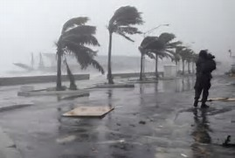
Precautions at the scene
-A deliberate, methodical, disciplined approach to collection and preservation of evidence is essential.
One exception……
Evidence Integrity is at Risk.
Notes:
Crime Scene Evidence (PO# D 1-3)
Items of physical crime scene evidence are not always visible to the naked eye and may be easily overlooked, A deliberate, methodical, disciplined approach to collection and preservation of evidence is essential.
One exception may be lf crime scene evidence integrity is at risk, and under those circumstances It is important that rapid decisions be made to
prevent its degradation and/or loss.

Slide 15
Precautions at the scene
Types of Equipment Include:
-Tyvek white paper body suit.
-Paper mask which covers nose and mouth.
-Eye Protection.
-Latex or Nitrile gloves.
-Sleeve protectors.
-Shoe covers.
-Hair net.
Notes:
Crime Scene Evidence (PO# D 1-3)
Types of equipment used:

Slide 16
Evidence Collection and Removal
Types of Evidence Include:
-Fingerprints
-Footwear impressions
-Hair
-Fibers
-Biological fluids
-materials for DNA analysis
-Anything used to commit the crime
Notes:
Crime Scene Evidence (PO# D 1-3)
The Crime scene Investigator should prioritize the order in which evidence is collected.
Biological evidence, trace materials, and evidence of a fragile nature should be collected first.
Collection methods used to gather and package this crime scene evidence vary.
The use of an alternate Light Source (ALS) or oblique lighting may be necessary.
A sample detected with the ALS should be properly packaged with a notation alerting the analyst that it is a luminescent sample.

Slide 17
Preservation of Evidence
From the Crime Scene….
All evidence must be inventoried and secured to preserve its integrity.
To the courtroom.
Notes:
Preservation of Evidence From crime scene to forensic laboratory to courtroom, all evidence must be inventoried and secured to preserve its integrity. Crime scene evidence admissibility ln court is predicated upon an unbroken chain or custody. it is important to demonstrate that the evidence introduced at trial is the same evidence collected at the crime scene, and that access was controlled and documented.

Slide 18
Cell Phones

Slide 19
Computer Crimes Evidence
Seizure of Devices Containing Electronic Evidence:
Cellular Telephones
Computers
Media Players such as Ipods or (Purchased MP3 Player from store are approved.)
Corrections staff seizing electronic evidence should handle evidence as little as possible and under no circumstances should staff turn these devices on or attempt to extract information form them.

Slide 20
Chain-of-Custody
Proper evidence packaging includes:
- Appropriate packaging and labeling of all items, each item properly sealed, marked, correct and consistent information recorded on labels and procedural documentation.
Notes:
An understanding of. The rules governing chain-of-custody is vital for an investigator. For example, in a sexual. Assault incident, the victim ls typically transported to another location to have a sexual assault examination performed. Many jurisdictions have established teams to perform these examinations, and they go by several names such as: sexual Assault Victim Examination (S.A.V.E.), sexual Assault-Nurse Examiner (S.A.N.E), sexual assault Response Team (S.A.R.T) . The examination involves the collection of the victims clothing, hair samples, swabs for body fluids, and documentation of bruising and bite-marks. The materials collected are packaged by the team members.

Slide 21
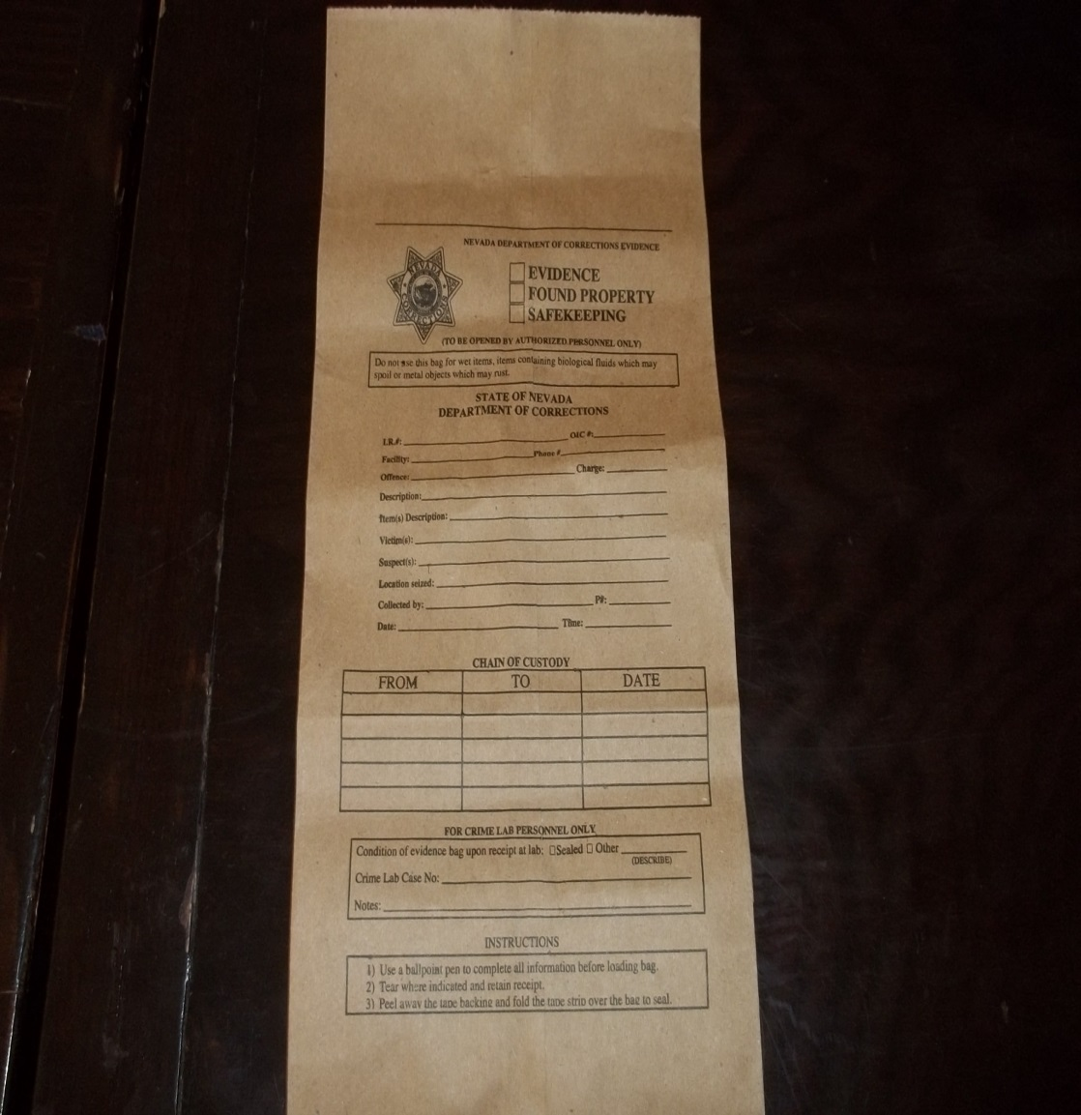
Chain-of-Custody
Notes:
The evidence ls marked and packaged for submission to a department's property and evidence section. This may start by placing evidence ln a locker or bin (agency policy and storage capabilities). Generally, submissions to the forensic laboratory are done on a request for analysis form, listing the evidence items, and a documented chain of custody. Each individual assuming custody of the evidence from collection through analysis signs the chain of custody document. Some departments have automated this process using an information management system, whereby all transfers are securely done using barcodes. The chain of custody report (or the form used for packaging) will identify each individual contributing to the analysis of the evidentiary materials.

Slide 22
Chain-of-Custody
Make sure your information is accurate
Information must be consistent on all paperwork; who, what, when, where, etc..
Do not use generic terms when describing contraband (i.e. shank, etc.)
Be as specific as possible to describe item
Don’t make assumptions, report facts

Slide 23
Chain-of-Custody
1. The chain of custody begins when the item is collected.
2. Any time contraband is turned over from one person to another, the person receiving it shall sign for it before taking possession.

Slide 24
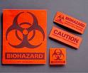
Chain-of-Custody
Biological Fluids and Stains:
-Proper handling is essential
A. Use disposable gloves.
B. Any item confiscated that has blood, semen, urine, etc. should be handled with extreme care. Most items should be packaged in paper bags and all should be marked “Biohazard.”
Notes:
Crime Scene Evidence continued: ( PO#D1-3) Since blood and other body fluid evidence ls biological and is rapidly decomposed by bacteria and mold, it ls absolutely essential that such evidence ls handled properly. Remember safety measures for biological hazards. Always wear disposable gloves when handling material stained with blood or other body fluids. Check with your agency's safety protocols for biological hazards.
All items should be sealed and labeled for identification per your department policy. Evidence collection materials such as envelopes, bags, etc. will dictate how you package fluids and stains.

Slide 25
Chain-of-Custody
Biological Fluids and Stains:
-Rape Evidence
Notes:
Crime Scene Evidence continued: ( PO#D1-3) Evidence normally collected in rape or sodomy cases includes a variety of samples which are relatively constant from case to case.
In the case of a violent crime such as a sexual assault, attention may be directed to the clothing and the person of the victim(s) and the suspect(s). An investigator might find body fluids, stains, torn clothing, fingerprints, fibers, hair, and other trace materials ln the areas where the attack took place. Potential crime scene evidence such as saliva, bite marks,
semen, hair, skin tissue under the flinger nails, and other trace materials may be found on the victim(s).
Transferred evidence such as cosmetics, vaginal fluid, hair from the victim, and blood may also be found on the suspect. Once potential evidence ls located and documented, the next step 's to collect and package the items ln a manner that prevents contamination, loss, and deleterious change.

Slide 26
Chain-of-Custody
Biological Fluids and Stains:
-Stains on Garments or Fabrics
A. Wet stained fabrics must air dry.
B. Package multiple items separately
C. DO NOT USE PLASTIC BAGS
Notes:
Make sure that all stains and clothing are DRYI If the stain ls wet, it must be air dried away from heat and sunlight, preferably in a secure, ventilated room. The victims Items should be separated from those Of the suspect during drying.
Package each item-m separately to avoid contamination and ln paper to avoid further decomposition. Paper bags are recommended. DO NOT USE PLASTIC since plastic does not "breathe" and holds ln molstu.re, permitting bacterial and fungal growth.

Slide 27
Chain-of-Custody
Biological Fluids and Stains:
-Stains on Garments or Fabrics
D. Avoid unnecessary handling of garments with blood or seminal stains.
E. Initial and dated in an area away form the stain.
F. Label and seal all items
Notes:
3. Avoid unnecessary handling. Of garments with blood or seminal stains.
4. Each item should be initialed and dated In an area away form the stain.
5. All items should be sealed and labeled for identification per your department policy.
Evidence collection materials such as envelopes, bags etc.. Will dictate how you package and log hairs and fibers.

Slide 28
Chain-of-Custody
Biological Fluids and Stains:
-Stains on Surfaces
1. Items to be checked for blood should not be dusted for Prints.
2. Whenever possible, submit the bloodstained item itself for analysis. If this is impractical, detach or cut out the part with the stain for submission. Carefully package to avoid contamination or loss. Do not put any tape directly on the stain.

Slide 29
Chain-of-Custody
Biological Fluids and Stains:
-Stains on Surfaces
3. Bloodstains can be swabbed off items which cannot be submitted. Swab the blood onto a cotton-tipped applicator that has been slightly dampened with distilled water, in a manner which concentrates the sample. Swab and unstained area of the same surface in the same manner for a control. Air dry and package the stain and control swabs separately in paper.

Slide 30
Chain-of-Custody
Biological Fluids and Stains:
-Stains on Surfaces
4.Concentrated stains on walls, floors, etc. (i.e., items that cannot be cut out and submitted), can be scraped off into a piece of paper which is thecarefully folded and then placed in a pillbox or other suitable container. This container and the paper should be initialed and dated or otherwise identified.

Slide 31
Chain-of-Custody
Biological Fluids and Stains:
-Stains on Surfaces
5. If the stain is moist, let it air dry first, or swab it onto a cotton tipped applicator then air dry.
Notes:
The sample should then be submitted to the lab as soon as possible, along with the rest of the evidence. In the period between obtaining the blood sample and transporting it to the lab.

Slide 32
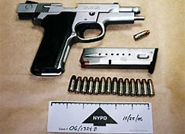
Chain-of-Custody
Firearms & Ammunition
1. Always unload the firearm before submitting it for evidence.
Notes:
Firearms: Always unload a firearm when it is placed into evidence. Always unload the firearm before submitting it for evidence. If the firearm is a revolver, indicate the position of the cylinder as well as the chamber from which each cartridge or cartridge case was unloaded. This can be done by etching the cylinder on each side of the top strap (that part of the frame directly above the cylinder) and numbering each cartridge or cartridge case as it is removed. A Diagram indicating cartridge/Cartridge case positions should be made and submitted with the firearm.
All items should be sealed and labeled for identification

Slide 33
Chain-of-Custody
Hairs and fibers
A. Hair evidence is generally small
B. Detecting hair 1. visual search, alternate light sources, magnification search.
2. picking, scraping, combing, or vacuuming.
Notes:
Hair s a common type of evidence found ln a variety of different types of criminal cases,
1. Since hair evidence ls generally small in nature, care should be taken to protect evidence from loss or contamination.
2. Several methods could be used ln the detecting of hair evidence: visual searches, alternate light sources and searches with additional magnification.
3. For hair evidence this could include: picking, scraping, combing, or vacuuming.

Slide 34
Chain-of-Custody
Hairs and fibers
C. If the location of a foreign hair is important, they should be collected and packaged separately.
D. Wrap clothing or evidence items separately.
Notes:
4. If the location of a foreign hair is important, they should be collected and packaged separately.
5. Wrap clothing or evidence items separately.
All items should be sealed and labeled for identification

Slide 35
Chain-of-Custody
Tool marks and tools:
- impression, cut, gouge, or abrasion caused by a tool coming into contact with another object.
- may be photographed , if easily removed it may be taken as evidence.
- hard to accurately reproduce the tool mark for future comparison.
Notes:
Tool marks and tools
A tool mark(s) are any impression. cut, gouge, or abrasion caused by a tool coming into contact with another object. Throughout the years many different materials have been utilized both in the field and in the laboratory setting to try to accurately replicate the class and/or individual details inherent in a particular tool mark or tool.
Marks may be photographed or if the item that the mark is on can be removed easily, it may be taken as evidence. Department policy is used when taking large items.
Crime scene investigators are intimately aware of the problems associated with attempts to accurately record tool marks at crime scenes both photographically and otherwise. The location of the tool mark, the surface containing the tool mark, and the characteristics of the tool creating the mark can all affect the investigator's ability to accurately reproduce the tool mark for future comparison,

Slide 36
Overview
Finishing processing:
Final survey is a review of all aspects of the search
Discuss he search with all personnel
Photograph the scene showing the final condition
Ensure all evidence is secured
Ensure all equipment is retrieved
Ensure hiding places or difficult access areas have not been overlooked
Notes:
Have student (s) read

Slide 37
Overview
Release:
Release the crime scene after the final survey
Crime scene release documentation should include the time and date of release, to whom released, and by whom released
Ensure that the evidence is collected according to legal requirements, documented, policy and marked for identification
Consider the need for specialists such as a blood-pattern analyst or a medical examiner to observe the scene before it is released
Notes:
Have student (s) read

Slide 38
Overview
Release:
Once the scene has been released reentry may require a warrant
The scene should be released only when all personnel are satisfied that the scene was searched correctly and completely
Only the person in charge should release the scene
Notes:
Have student (s) read

Slide 39
Chain of Custody for Evidence
The Chain of Custody requires three Types of Testimony:
1. Testimony that a piece of evidence is what it purports to be
2. Testimony of continuous possession by each individual
3. Testimony by each person who had possession that the particular piece of evidence remained in substantially the same condition from possession of one person to another
Notes:
(PO# 5) Proof of a chain of custody is required when the evidence that is sought to be introduced at trial is not unique or where the relevance of the evidence depends on its analysis after seizure. A proper chain of custody requires three types of testimony
Testimony that a piece of evidence is what it purports to be (for example, a litigant's blood sample);
(2) Testimony of continuous possession by each individual who has had possession of the evidence from the time it is seized until the time it is presented in court;
(3)Testimony by each person who has had possession that the particular piece of evidence remained in substantially the same condition from the moment one person took possession until the moment that person released the evidence into the custody of another (for example, testimony that the evidence was stored in a secure location where no one but the person in custody had access to it).
Proving chain of custody is necessary to "lay a foundation" for the evidence in question, by showing the absence of alteration, substitution, or change of condition. Specifically, foundation testimony for tangible evidence requires that exhibits be identified as being in substantially the same condition as they were at the time the evidence was seized, and that the exhibit has remained in that condition through an unbroken chain of custody.
For example, suppose that in a prosecution for possession of illegal narcotics, police sergeant A recovers drugs from the defendant; A gives police officer B the drugs; B then gives the drugs to police scientist C, who conducts an analysis of the drugs; C gives the drugs to police detective D, who brings the drugs to court. The testimony of A, B, C, and D constitute a "chain of custody" for the drugs, and the prosecution
would need to offer testimony by each person in the chain to establish both the condition and identification of the evidence, unless the defendant stipulated as to the chain of custody in order to save time,
Chain of custody need not be demonstrated for every piece of tangible evidence that is accepted into the trial court's record. Physical evidence that is readily identifiable by the witness might not need to be
supported by chain-of-custody proof. For example, no chain-of-custody foundation is required for items that are imprinted with a serial number or inscribed with initials by an officer who collected the evidence. Similarly, items that are inherently distinctive or memorable (for example, a holdup note written in purple crayon) might be sufficiently unique and identifiable that they establish the integrity of the evidence.

Slide 40
Packaging
All packages should contain the following information:
Description of the item – use generic terms, not jail lingo like “shank”
Where it was found
Person’s name and number (if applicable)
Date and time found
Name of staff seizing the item
PAPERWORK ATTACHED TO PACKAGING IS NOT ENOUGH!!
Notes:
From Contraband and Evidence IST 2016

