Slide 1
Standardized Awareness Authorized Training, Train-the-Trainer
Chemical Agents

Slide 2
Objectives
Discuss chemical agents, such as Toxic Industrial Chemicals (TIC), Riot Control Agents (RCA), and Chemical Warfare Agents (CWA), as well as the physiological signs/symptoms associated with them.
Discuss the advantages and disadvantages of using chemical agents for terrorist activity.
Identify potential sources in the community where chemicals are manufactured, transported, stored, used, or disposed.

Slide 3
Objectives (continued)
Discuss the TRACEM-P acronym.
Identify the indicators of a possible criminal/terrorist act involving chemical agents.
Discuss the control zones used during a chemical agent incident.
Discuss instructional strategies for facilitating the “Chemical Agents” module.

Slide 4
Chemical Agents
Types
Dissemination
Availability
Volatility
Vapor Density
Senses
Routes of Entry; inhalation, ingestion, absorption, injection
General Signs and/or Symptoms

Slide 5
Types of Chemical Agents
Toxic Industrial Chemicals
Anhydrous ammonia
Chlorine
Hydrogen cyanide
Incapacitating Agents
Riot Control Agents; only a temporary irritating effect

Slide 6
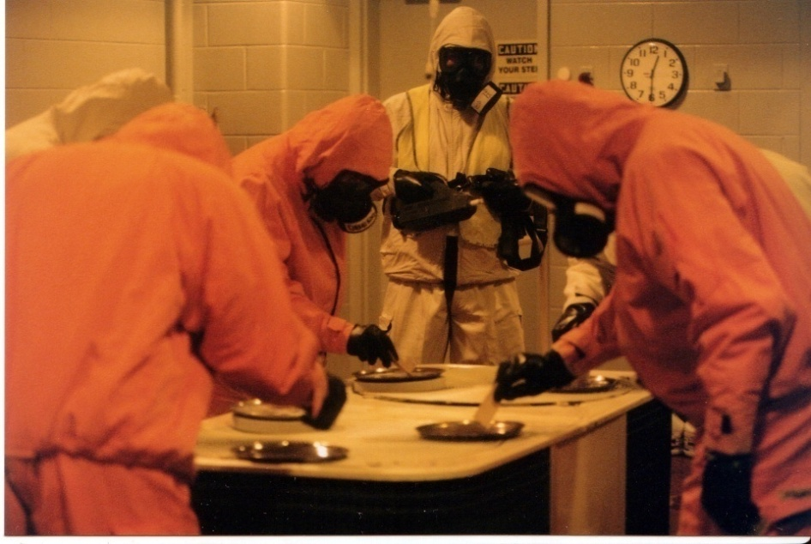
Chemical Warfare Agents
Choking Agents; dry land drowning
Blood Agents
Blister Agents; blanched skin, skin inflammation, pulmonary edema, eye irritation
Nerve Agents; sweating, drooling, runny nose, pinpointed pupils
Courtesy of the CDP

Slide 7
Nerve Agent Signs and Symptoms
SLUDGEM:
Salivation (drooling)
Lacrimation (tears)
Urination
Defecation
Gastric distress (stomach)
Emesis (vomiting)
Miosis (constriction of pupils)

Slide 8
Advantages of Using Chemical Agents for Terrorist Activity
Easy to make or acquire
Available
Immediate effect
Hard to detect
Easily spread
Tie up resources
Psychological impact

Slide 9
Disadvantages of Using Chemical Agents for Terrorist Activity
Requires large quantities
Production and deployment hazardous to terrorists

Slide 10
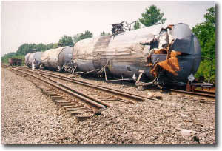
Sources of Toxic Industrial Chemicals (TIC)
Chemical manufacturing plants
Food processing facilities
Transportation assets
Airports
Industries
Laboratories
Courtesy of the Indiana Department of Environmental Management

Slide 11
TRACEM-P
TRACEM-P outlines potential hazards and mechanisms of injury at a hazardous materials incident
Thermal
Radiological
Asphyxiation
Chemical
Etiological
Mechanical
Psychological

Slide 12
Indicators of a Possible CWA Attack
Numerous dead animals
Lack of insect life
Mass casualties
Unexplained physical symptoms
Pattern of casualties
Illness in a confined geographic area
Courtesy of CDC Public Health Image Library (PHIL) # 8518

Slide 13
Indicators of a CWA Attack (continued)
Unusual liquid droplets
Areas of dead vegetation
Unexplained odors
Numerous people experiencing blisters
Low-lying cloud/fog conditions
Unusual metal debris/bomb-like materials present

Slide 14
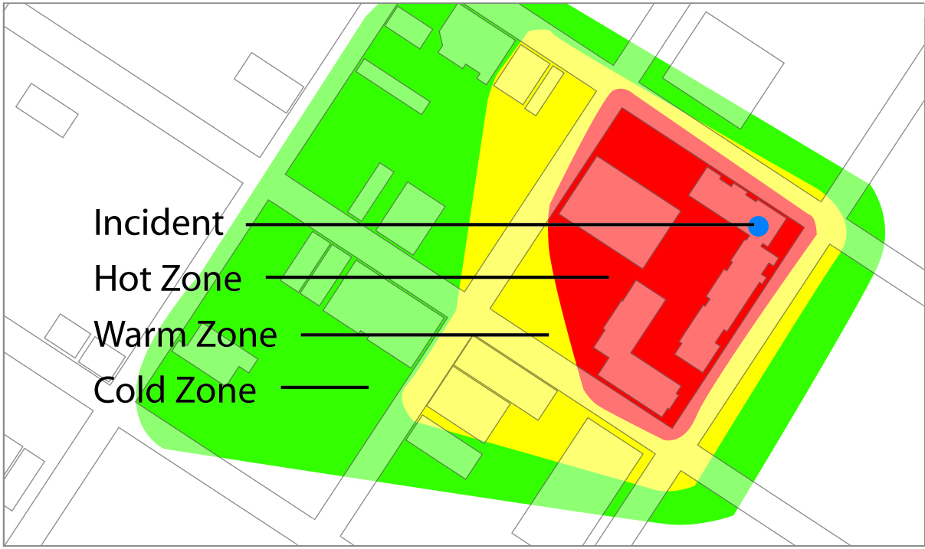
Control Zones
Courtesy of CDP

Slide 15
Activity
Courtesy of Rob Low

Slide 16
Questions for Presentation Preparation
How will you explain the importance of learning this module to your participants?
What do participants need to learn from this module content?
What additional resources can be used to reinforce learning the content in this module?
How will you involve the audience in learning this material?
What safety concerns need to be reinforced in this module?

Slide 17
Conclusion
What are the characteristics and physiological signs/symptoms associated with chemical agents, TIC, RCA, and CWA?
What are some advantages and disadvantages of using chemical agents for terrorist activity?
What are some potential sources in the community where chemicals are manufactured, transported, stored, used, or disposed?

Slide 18
Conclusion (continued)
What are the potential hazards encountered by a responder at a HAZMAT incident, as represented by the acronym TRACEM-P?
What are the indicators of a possible criminal/terrorist act involving chemical agents?
How would you use control zones for a chemical agent incident?
What are some potential instructional strategies you could use to facilitate the “Chemical Agents” module?

Slide 19
Standardized Awareness Authorized Training, Train-the-Trainer
Chemical Agents—End of Module

