Slide 1
USE of Force
Nevada Department of Corrections
AR 405

Slide 2
Preamble to Use of Force
It is the intent of the Nevada Department of Corrections that all staff recognize the value of human life, respect basic human rights & have an intolerant attitude towards abusive or excessive force used on inmates. An officers use of force shall be value driven, utilizing only the minimal amount of force that is necessary & reasonable under the circumstances to minimize the chance of harm to themselves or others, to prevent escapes, to protect state property from destruction, to prevent or quell a disturbance or compel compliance to lawfully issued orders.
Notes:
It is the intent of the Nevada Department of Corrections that all staff recognize the value of human life, respect basic human rights & have an intolerant attitude towards abusive or excessive force used on inmates. An officers use of force shall be value driven, utilizing only the minimal amount of force that is necessary & reasonable under the circumstances to minimize the chance of harm to themselves or others, to prevent escapes, to protect state property from destruction, to prevent or quell a disturbance or compel compliance to lawfully issued orders.

Slide 3
Purpose of Course
To become thoroughly proficient in the knowledge of Use of Force and the application of the legal and appropriate levels of force.
Notes:
To become thoroughly proficient in the knowledge of Use of Force and the application of the legal and appropriate levels of force.

Slide 4
Responsibility
The Warden/Division Head is responsible for the overall execution of this regulation. Direct supervision of this regulation is the responsibility of the Shift Supervisor (institutions/facilities) and/or the Transportation Lieutenant/Sergeant in regards to Central Transportation Division.
The Warden at each institution will ensure that all assigned staff is trained and have signed an acknowledgement statement that they have read, know and understand this regulation. A copy of their acknowledgement will be maintained in each staff members personnel file.
Notes:
The Warden/Division Head is responsible for the overall execution of this regulation. Direct supervision of this regulation is the responsibility of the Shift Supervisor (institutions/facilities) and/or the Transportation Lieutenant/Sergeant in regards to Central Transportation Division.
The Warden at each institution will ensure that all assigned staff is trained and have signed an acknowledgement statement that they have read, know and understand this regulation. A copy of their acknowledgement will be maintained in each staff members personnel file.

Slide 5
Definitions
Authorized Personnel – A person who has received the prescribed NDOC training in the application of Use of Force equipment or tactics, and whose qualifications are up-to-date.
Deadly Force – Any force which carries a substantial risk that it will result in death or serious physical injury.
Excessive Force – The use of more force than an objective trained and competent correctional peace officer faced with similar facts and circumstances would use to subdue an attacker, overcome resistance, affect custody or gain compliance with a lawful order.
Force – Any violence, compulsion, or constraint physically exerted by any means upon or against a person
Notes:
Authorized Personnel – A person who has received the prescribed NDOC training in the application of Use of Force equipment or tactics, and whose qualifications are up-to-date.
Deadly Force – Any force which carries a substantial risk that it will result in death or serious physical injury.
Excessive Force – The use of more force than an objective trained and competent correctional peace officer faced with similar facts and circumstances would use to subdue an attacker, overcome resistance, affect custody or gain compliance with a lawful order.
Force – Any violence, compulsion, or constraint physically exerted by any means upon or against a person

Slide 6
Definitions
Less Lethal Force – any force that is neither intended nor likely to cause death or serious bodily harm.
Passive Compliance Measures – Techniques/strategies used by staff to gain compliance/control of an inmate without forcible physical contact.
Planned Use of Force – The Use of Force when time and circumstances allow the opportunity for planning and consultation and approval of the Warden or Administrator Off Duty (AOD)
Notes:
Less Lethal Force – any force that is neither intended nor likely to cause death or serious bodily harm.
Passive Compliance Measures – Techniques/strategies used by staff to gain compliance/control of an inmate without forcible physical contact.
Planned Use of Force – The Use of Force when time and circumstances allow the opportunity for planning and consultation and approval of the Warden or Administrator Off Duty (AOD)

Slide 7
Definitions
Physical Force (Hands On) – The use of hands, other parts of the body, objects, instruments, chemical devices, firearms, or other physical methods for the purpose of overcoming the resistance to lawful authority.
Reasonable Force – That force which is objectively reasonable based on the totality of the circumstances and the facts known to the officer at the time to subdue an attacker, overcome resistance, affect custody, or gain compliance with a lawful order.
Show of Force – Movement of appropriate staff and/or equipment/weapon to an incident site for the purpose of convincing an inmate that adequate staff and measures are available and will be used to successfully resolve the situation.
Skip Shot – A live round (rubber or bird-shot) discharged from a 12gauge shotgun that is fired at the ground one to two yards in front of the intended inmate so that the individual live rounds skip off the ground/floor striking the intended inmate(s) lower extremities.
Notes:
Physical Force (Hands On) – The use of hands, other parts of the body, objects, instruments, chemical devices, firearms, or other physical methods for the purpose of overcoming the resistance to lawful authority.
Reasonable Force – That force which is objectively reasonable based on the totality of the circumstances and the facts known to the officer at the time to subdue an attacker, overcome resistance, affect custody, or gain compliance with a lawful order.
Show of Force – Movement of appropriate staff and/or equipment/weapon to an incident site for the purpose of convincing an inmate that adequate staff and measures are available and will be used to successfully resolve the situation.
Skip Shot – A live round (rubber or bird-shot) discharged from a 12gauge shotgun that is fired at the ground one to two yards in front of the intended inmate so that the individual live rounds skip off the ground/floor striking the intended inmate(s) lower extremities.

Slide 8
Definitions
Spontaneous Use of Force – Actions that staff may immediately take in response to an emergency situation.
Use of Force – The application of progressive levels of force to gain control of an inmate up to and including deadly force. This does not include those situations in which security restraints are used in a standard manner for arrest, escort or transport. (Use of Force will be limited to the minimal amount of force necessary to control the situation.)

Slide 9
Use of Force Against a “Threat”
In Tennessee v. Garner and Graham v. Conner the Supreme Court stated an officer must consider the “Immediate Threat” to the officer or others when using force.
In training, we want to instill in the officer that he/she is only justified in using force if the suspect/inmate is a “Threat” or “Immediate Threat” to the officer or others.
In a trial, we want to inform the jury that officers are trained to refer to the suspect/inmate as the “Threat” to condition the officer only to use force on a suspect/inmate when the suspect or inmate is a threat to the officer or others.
Notes:
In Tennessee v. Garner and Graham v. Conner the Supreme Court stated an officer must consider the “Immediate Threat” to the officer or others when using force.
In training, we want to instill in the officer that he/she is only justified in using force if the suspect/inmate is a “Threat” or “Immediate Threat” to the officer or others.
In a trial, we want to inform the jury that officers are trained to refer to the suspect/inmate as the “Threat” to condition the officer only to use force on a suspect/inmate when the suspect or inmate is a threat to the officer or others.

Slide 10
Threat Defined
NRS 205.320 Threats. A person who, with the intent to extort or gain any money or other property or to compel or induce another to make, subscribe, execute, alter or destroy any valuable security or instrument or writing affecting or intended to affect any cause of action or defense, or any property, or to influence the action of any public officer, or to do or abet or procure any illegal or wrongful act, whether or not the purpose is accomplished, threatens directly or indirectly:
1. To accuse any person of a crime;
2. To injure a person or property;
3. To publish or connive at publishing any libel;
4. To expose or impute to any person any deformity or disgrace; or
5. To expose any secret,
is guilty of a category B felony and shall be punished by imprisonment in the state prison for a minimum term of not less than 1 year and a maximum term of not more than 10 years, or by a fine of not more than $10,000, or by both fine and imprisonment. In addition to any other penalty, the court shall order the person to pay restitution.
[1911 C&P § 474; RL § 6739; NCL § 10423]—(NRS A 1967, 502; 1979, 1445; 1995, 1223)
Notes:
NRS 205.320 Threats. A person who, with the intent to extort or gain any money or other property or to compel or induce another to make, subscribe, execute, alter or destroy any valuable security or instrument or writing affecting or intended to affect any cause of action or defense, or any property, or to influence the action of any public officer, or to do or abet or procure any illegal or wrongful act, whether or not the purpose is accomplished, threatens directly or indirectly:
1. To accuse any person of a crime;
2. To injure a person or property;
3. To publish or connive at publishing any libel;
4. To expose or impute to any person any deformity or disgrace; or
5. To expose any secret,
is guilty of a category B felony and shall be punished by imprisonment in the state prison for a minimum term of not less than 1 year and a maximum term of not more than 10 years, or by a fine of not more than $10,000, or by both fine and imprisonment. In addition to any other penalty, the court shall order the person to pay restitution.
[1911 C&P § 474; RL § 6739; NCL § 10423]—(NRS A 1967, 502; 1979, 1445; 1995, 1223)

Slide 11
Definitions
“Vicarious Liability”
Vicarious liability refers to liability for the negligent or criminal acts of another person that is assigned to someone by law. Vicarious liability exists when liability is attributed to a person who has control over or responsibility for another who negligently causes an injury or otherwise would be liable. Whenever an agency relationship exists, the principal is responsible for the agent's actions.
For example, an employer of an employee who injures someone through negligence while in the scope of employment is vicariously liable for damages to the injured person.
Notes:
“Vicarious Liability”
Vicarious liability refers to liability for the negligent or criminal acts of another person that is assigned to someone by law. Vicarious liability exists when liability is attributed to a person who has control over or responsibility for another who negligently causes an injury or otherwise would be liable. Whenever an agency relationship exists, the principal is responsible for the agent's actions.
For example, an employer of an employee who injures someone through negligence while in the scope of employment is vicariously liable for damages to the injured person.

Slide 12
Liability
The Eighth Amendment (Amendment VIII) to the United States Constitution is the part of the United States Bill of Rights prohibiting the federal government from imposing excessive bail, excessive fines or cruel and unusual punishments, including torture. The U.S. Supreme Court has ruled that this amendment's Cruel and Unusual Punishment Clause applies to the states.
Notes:
The Eighth Amendment (Amendment VIII) to the United States Constitution is the part of the United States Bill of Rights prohibiting the federal government from imposing excessive bail, excessive fines or cruel and unusual punishments, including torture. The U.S. Supreme Court has ruled that this amendment's Cruel and Unusual Punishment Clause applies to the states.

Slide 13
Nevada Law
In keeping with the policy of the Department of Corrections prohibiting the use of excessive force, NRS 212.020 – “Inhumanity to Prisoners,” is noted as follows:
Notes:
In keeping with the policy of the Department of Corrections prohibiting the use of excessive force, NRS 212.020 – “Inhumanity to Prisoners,” is noted as follows:

Slide 14
a. Every jailer or person who shall be guilty of willful inhumanity or oppression to any prisoner under his care or custody shall be punished:
1) Where the prisoner suffers substantial bodily harm for such inhumanity or oppression, by imprisonment in the state Prison for not less than one year nor more than six years or by a fine of not more than $5,000.00 or both fine and imprisonment
2) Where no substantial bodily harm results, a gross misdemeanor.
b. Whether or not the prisoner suffers substantial bodily harm, any public officer guilty of such willful inhumanity is guilty of a maleficence of office.
Notes:
a. Every jailer or person who shall be guilty of willful inhumanity or oppression to any prisoner under his care or custody shall be punished:
1) Where the prisoner suffers substantial bodily harm for such inhumanity or oppression, by imprisonment in the state Prison for not less than one year nor more than six years or by a fine of not more than $5,000.00 or both fine and imprisonment
2) Where no substantial bodily harm results, a gross misdemeanor.
b. Whether or not the prisoner suffers substantial bodily harm, any public officer guilty of such willful inhumanity is guilty of a maleficence of office.

Slide 15
Title 18 United States Code Deprivation of Rights Under the Color of Law
This statute makes it a crime for any person acting under color of law, statute, ordinance, regulation, or custom to willfully deprive or cause to be deprived from any person those rights, privileges, or immunities secured or protected by the Constitution and laws of the U.S.
This law further prohibits a person acting under color of law, statute, ordinance, regulation or custom to willfully subject or cause to be subjected any person to different punishments, pains, or penalties, than those prescribed for punishment of citizens on account of such person being an alien or by reason of his/her color or race.
Notes:
*Not necessary to read, this just shows the law in which we fall under for this AR.
This statute makes it a crime for any person acting under color of law, statute, ordinance, regulation, or custom to willfully deprive or cause to be deprived from any person those rights, privileges, or immunities secured or protected by the Constitution and laws of the U.S.
This law further prohibits a person acting under color of law, statute, ordinance, regulation or custom to willfully subject or cause to be subjected any person to different punishments, pains, or penalties, than those prescribed for punishment of citizens on account of such person being an alien or by reason of his/her color or race.
Acts under "color of any law" include acts not only done by federal, state, or local officials within the bounds or limits of their lawful authority, but also acts done without and beyond the bounds of their lawful authority; provided that, in order for unlawful acts of any official to be done under "color of any law," the unlawful acts must be done while such official is purporting or pretending to act in the performance of his/her official duties. This definition includes, in addition to law enforcement officials, individuals such as Mayors, Council persons, Judges, Nursing Home Proprietors, Security Guards, etc., persons who are bound by laws, statutes ordinances, or customs.
Punishment varies from a fine or imprisonment or both, and if bodily injury results or if such acts include the use, attempted use, or threatened use of a dangerous weapon, explosives, or fire shall be fined or imprisoned up to ten years or both, and if death results, or if such acts include kidnapping or an attempt to kidnap, aggravated sexual abuse or an attempt to commit aggravated sexual abuse, or an attempt to kill, shall be fined.

Slide 16
Title 18 United States Code Deprivation of Rights Under the Color of Law
Acts under "color of any law" include acts not only done by federal, state, or local officials within the bounds or limits of their lawful authority, but also acts done without and beyond the bounds of their lawful authority; provided that, in order for unlawful acts of any official to be done under "color of any law," the unlawful acts must be done while such official is purporting or pretending to act in the performance of his/her official duties. This definition includes, in addition to law enforcement officials, individuals such as Mayors, Council persons, Judges, Nursing Home Proprietors, Security Guards, etc., persons who are bound by laws, statutes ordinances, or customs.
Punishment varies from a fine or imprisonment or both, and if bodily injury results or if such acts include the use, attempted use, or threatened use of a dangerous weapon, explosives, or fire shall be fined or imprisoned up to ten years or both, and if death results, or if such acts include kidnapping or an attempt to kidnap, aggravated sexual abuse or an attempt to commit aggravated sexual abuse, or an attempt to kill, shall be fined.

Slide 17
Graham vs Conner (Objective Reasonableness Standard)
The level of force that is necessary in a particular situation. The reasonableness of a particular use of force must be judged from the perspective of a reasonable officer on the scene, rather than with the 20/20 vision of hindsight. The calculus of reasonableness must embody allowance for the fact that police officers are often forced to make split second judgments-in circumstances that are tense, uncertain, and rapidly evolving-about the amount of force that is necessary in a particular situation. The reasonableness inquiry in an excessive force case is an objective one: the question is whether the officers’ actions are objectively reasonable in light of the facts & circumstances confronting them, without regard to their underlying intent or motivation.
Notes:
The level of force that is necessary in a particular situation. The reasonableness of a particular use of force must be judged from the perspective of a reasonable officer on the scene, rather than with the 20/20 vision of hindsight. The calculus of reasonableness must embody allowance for the fact that police officers are often forced to make split second judgments-in circumstances that are tense, uncertain, and rapidly evolving-about the amount of force that is necessary in a particular situation. The reasonableness inquiry in an excessive force case is an objective one: the question is whether the officers’ actions are objectively reasonable in light of the facts & circumstances confronting them, without regard to their underlying intent or motivation.

Slide 18
Force
Verbal
Control Restraint
Chemical Agent
Temporary
Incapiciation
Deadly Force
Deadly
Verbal
Officer
Temporary
Incapacitation
Presence
Control Restraint
Chemical Agent
Notes:
Verbal
Control Restraint
Chemical Agent
Temporary
Incapiciation
Deadly Force

Slide 19
Elements of Force
Non-Deadly : Deadly:
Ability Ability
Opportunity Opportunity
Jeopardy Imminent Jeopardy
Preclusion Preclusion
Notes:
Non-Deadly : Deadly:
Ability Ability
Opportunity Opportunity
Jeopardy Imminent Jeopardy
Preclusion Preclusion

Slide 20
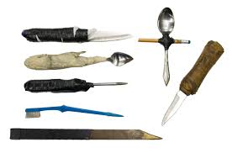
Ability or Apparent Ability
Does the violator/inmate possess the ability or the apparent ability to kill you or a third party, or to cause you or a third party great bodily harm?
Notes:
Does the violator/inmate possess the ability or the apparent ability to kill you or a third party, or to cause you or a third party great bodily harm?

Slide 21
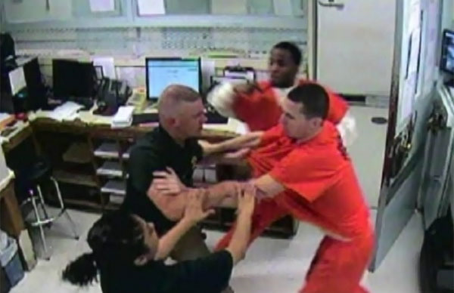
Opportunity
Does the violator/inmate have the opportunity to kill you or a third party, or cause you or a third party great bodily harm?
Notes:
Does the violator/inmate have the opportunity to kill you or a third party, or cause you or a third party great bodily harm?

Slide 22
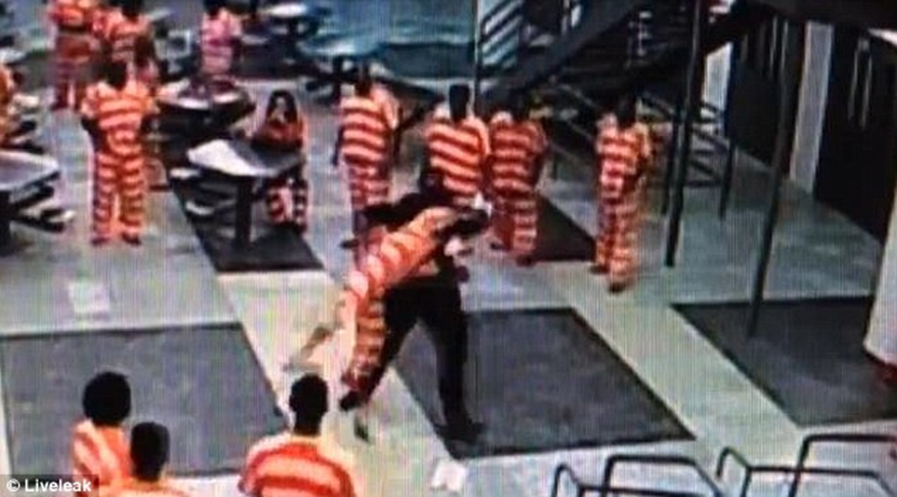
Jeopardy / Danger
Based on all facts & circumstances confronting the officer and without regard to the officers underlying intent or motivation, the officer reasonably believes that the subject poses a threat to the life of the officer(s) or other third parties and the must act to prevent death or serious bodily injury.
Notes:
Based on all facts & circumstances confronting the officer and without regard to the officers underlying intent or motivation, the officer reasonably believes that the subject poses a threat to the life of the officer(s) or other third parties and the must act to prevent death or serious bodily injury.

Slide 23
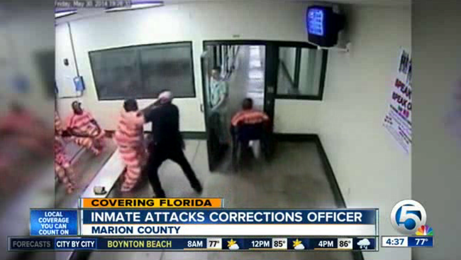
Imminent Jeopardy / Danger
Based on all facts & circumstances confronting the officer and without regard to the officers underlying intent or motivation, the officer reasonably believes that the subject poses an immediate threat to the life of the officer(s) or other third parties and the must act immediately to prevent death or serious bodily injury.
Notes:
Based on all facts & circumstances confronting the officer and without regard to the officers underlying intent or motivation, the officer reasonably believes that the subject poses an immediate threat to the life of the officer(s) or other third parties and the must act immediately to prevent death or serious bodily injury.

Slide 24
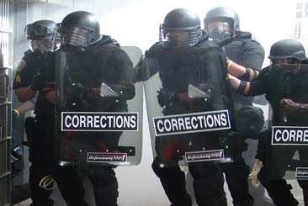
Preclusion
Have you reasonably exhausted all of your avenues of retreat at that time and at that place? Was there the feasibility or availability of alternative actions?
Notes:
Have you reasonably exhausted all of your avenues of retreat at that time and at that place? Was there the feasibility or availability of alternative actions?

Slide 25
405.01 – Use of Force General Provisions
The NDOC shall operate under this use of force policy that defines staff responsibilities and limitations concerning the use of force while still allowing discretion in the appropriate application of force. The policy provides staff with the appropriate guidance on the permissible Use of Force. It ensures discipline is imposed for violations of the Use of Force policy, procedures or training.
Notes:
The NDOC shall operate under this use of force policy that defines staff responsibilities and limitations concerning the use of force while still allowing discretion in the appropriate application of force. The policy provides staff with the appropriate guidance on the permissible Use of Force. It ensures discipline is imposed for violations of the Use of Force policy, procedures or training.

Slide 26
405.01 – Use of Force General Provisions
It is the policy of the NDOC to authorize the use of physical force when and only to the extent that is reasonably believed to be necessary as specified in these rules. Staff is authorized to use that amount of force that is objectively reasonable to overcome a threat thereby minimizing the risk of injury to the officer, the threat and the public.
At no time are staff permitted to use force for punishment, retaliation or discipline.
Notes:
It is the policy of the NDOC to authorize the use of physical force when and only to the extent that is reasonably believed to be necessary as specified in these rules. Staff is authorized to use that amount of force that is objectively reasonable to overcome a threat thereby minimizing the risk of injury to the officer, the threat and the public.
At no time are staff permitted to use force for punishment, retaliation or discipline.

Slide 27
405.01 – Use of Force General Provisions
Force shall be used only when reasonably necessary to subdue an attacker, overcome resistance, affect custody, or to gain compliance with a lawful order. It is the policy of the NDOC to accomplish the educational, treatment and supervision functions with minimal reliance on the use of force. Staff may use reasonable force as required in the performance of their duties, but unnecessary or excessive force shall not be used. If staff, at any point, determines the situation can be resolved without any further use of force, staff shall terminate the use of force.
Notes:
Force shall be used only when reasonably necessary to subdue an attacker, overcome resistance, affect custody, or to gain compliance with a lawful order. It is the policy of the NDOC to accomplish the educational, treatment and supervision functions with minimal reliance on the use of force. Staff may use reasonable force as required in the performance of their duties, but unnecessary or excessive force shall not be used. If staff, at any point, determines the situation can be resolved without any further use of force, staff shall terminate the use of force.

Slide 28
405.02 STAFF TRAINING INVOLVING USE OF FORCE
All personnel will receive training and be qualified prior to being assigned to a position involving possible Use of Force and being authorized to use any force related equipment such as physical restraints, firearms, chemical agents (CS/OC), TASER or similar technology or batons. A staff member employed in positions that are authorized to use force-related equipment will receive annual refresher and semi-annual firearms qualification training in the correct use of all equipment to maintain their established proficiency levels.
Notes:
All personnel will receive training and be qualified prior to being assigned to a position involving possible Use of Force and being authorized to use any force related equipment such as physical restraints, firearms, chemical agents (CS/OC), taser or similar technology or batons. A staff member employed in positions that are authorized to use force-related equipment will receive annual refresher and semi-annual firearms qualification training in the correct use of all equipment to maintain their established proficiency levels.

Slide 29
405.02 STAFF TRAINING INVOLVING USE OF FORCE
Training will include:
Techniques/strategies known as Passive Compliance Measures used by staff to gain compliance/control of an inmate without forcible physical contact such as: communications, videotaping of inmate(s), show of force.
Staff is expected to know the Continuum of Force and be able to apply the proper level and type of force needed to control an inmate’s behavior. Minimum harm to staff, the public and inmates is the goal, but the overall objective is to gain compliance, control, and facility order. Force should be limited to the minimum amount necessary to control the situation. Force will not be used to punish, harass, coerce, or abuse inmates.
Notes:
Training will include:
Techniques/strategies known as Passive Compliance Measures used by staff to gain compliance/control of an inmate without forcible physical contact such as: communications, videotaping of inmate(s), show of force.
Staff is expected to know the Continuum of Force and be able to apply the proper level and type of force needed to control an inmate’s behavior. Minimum harm to staff, the public and inmates is the goal, but the overall objective is to gain compliance, control, and facility order. Force should be limited to the minimum amount necessary to control the situation. Force will not be used to punish, harass, coerce, or abuse inmates.

Slide 30
405.03 When Force May Be Used
1. A staff member may use force to protect himself or any other individual from physical harm by an inmate.
2. Force will be proportionate to the threat exhibited by the inmate, and the force will decrease as the threat is lessened.
Any staff witnessing a Use of Force that is either excessive or unnecessary is required to immediately report their observations to the shift supervisor both verbally and in a written report.
Notes:
A staff member may use force to protect himself or any other individual from physical harm by an inmate.
Force will be proportionate to the threat exhibited by the inmate, and the force will decrease as the threat is lessened.
Any staff witnessing a Use of Force that is either excessive or unnecessary is required to immediately report their observations to the shift supervisor both verbally and in a written report.

Slide 31
405.03 When Force May Be Used
3. To prevent the escape of an inmate, staff may use reasonable force to prevent the escape if no alternative method of persuasion is effective.
Notes:
3. To prevent the escape of an inmate, staff may use reasonable force to prevent the escape if no alternative method of persuasion is effective.

Slide 32
405.03 When Force May Be Used
4. To prevent destruction of state property.
A. Staff may use force to prevent state property from substantial damage by an inmate if no alternative method of persuasion is effective.
B. Nevada Revised Statute (NRS) 212.190 states that damaging prison property is at least a gross misdemeanor.
Notes:
4. To prevent destruction of state property.
A. Staff may use force to prevent state property from substantial damage by an inmate if no alternative method of persuasion is effective.
B. Nevada Revised Statute (NRS) 212.190 states that damaging prison property is at least a gross misdemeanor.

Slide 33
405.03 When Force May Be Used
5. To compel an inmate’s compliance with orders, force may be used if no alternative method of persuasion is effective or where the circumstances require urgency.
6. To prevent or quell a disturbance, disperse or apprehend inmates whose conduct is creating a risk of death or serious physical injury to others.
Notes:
5. To compel an inmate’s compliance with orders, force may be used if no alternative method of persuasion is effective or where the circumstances require urgency.
6. To prevent or quell a disturbance, disperse or apprehend inmates whose conduct is creating a risk of death or serious physical injury to others.

Slide 34
405.03 When Force May Be Used
7. Levels of Force:
A. Planned use of force can be used at any level in the use of force continuum. Planned use of force incidents should be videotaped. Staff involved in these incidents should utilize protective equipment. An example of planned use of force is a cell extraction.
a. In a planned use of force, the Incident Commander in charge will assign a staff member to be in charge of recording the entire planned use of force.
Notes:
7. Levels of Force:
A. Planned use of force can be used at any level in the use of force continuum. Planned use of force incidents should be videotaped. Staff involved in these incidents should utilize protective equipment. An example of planned use of force is a cell extraction.
a. In a planned use of force, the Incident Commander in charge will assign a staff member to be in charge of recording the entire planned use of force.

Slide 35
405.03 When Force May Be Used
b. The staff member assigned to recording will ensure, prior to the start of the use of force, that the recording equipment has sufficient batteries and sufficient blank recording space, such that technical issues with recording will be minimized once recording begins.
Notes:
b. The staff member assigned to recording will ensure, prior to the start of the use of force, that the recording equipment has sufficient batteries and sufficient blank recording space, such that technical issues with recording will be minimized once recording begins.

Slide 36
405.03 When Force May Be Used
c. The staff member assigned to recording should not be expected to participate in the use of force and should not do so, such that they may dedicate their full attention to recording. The recording staff member should refrain from engaging in verbal comments during the recording, as staff comments will obscure the sounds being recorded. The recording staff member must also record in such a manner that the inmate is in focus as much as possible, and adjust their positions should a staff member’s body position be obscuring a visual of the inmate.
Notes:
c. The staff member assigned to recording should not be expected to participate in the use of force and should not do so, such that they may dedicate their full attention to recording. The recording staff member should refrain from engaging in verbal comments during the recording, as staff comments will obscure the sounds being recorded. The recording staff member must also record in such a manner that the inmate is in focus as much as possible, and adjust their positions should a staff member’s body position be obscuring a visual of the inmate.

Slide 37
405.03 When Force May Be Used
d. All recordings of a planned use of force should be kept in a manner and location that is easily retrievable in the event review is needed. The recording must be maintained for no less than three years from the date force was used.
Notes:
d. All recordings of a planned use of force should be kept in a manner and location that is easily retrievable in the event review is needed. The recording must be maintained for no less than three years from the date force was used.

Slide 38
405.03 When Force May Be Used
B. Spontaneous use of force may be used by staff to respond to an emergency when there is not time to formulate a plan or notify an immediate supervisor, and the situation constitutes a serious threat to the safety of staff, public, inmates and prison security. Immediate use of force should be employed in a manner that poses the least risk to staff, the public and inmates.
Notes:
B. Spontaneous use of force may be used by staff to respond to an emergency when there is not time to formulate a plan or notify an immediate supervisor, and the situation constitutes a serious threat to the safety of staff, public, inmates and prison security. Immediate use of force should be employed in a manner that poses the least risk to staff, the public and inmates.

Slide 39
405.03 When Force May Be Used
a. Where force was used spontaneously, regardless of injuries reported contemporaneous with the event, the area supervisor/incident commander will immediately review, if available, any unit video surveillance that may have captured the use of force.
Notes:
a. Where force was used spontaneously, regardless of injuries reported contemporaneous with the event, the area supervisor/incident commander will immediately review, if available, any unit video surveillance that may have captured the use of force.

Slide 40
405.03 When Force May Be Used
b. If the use of force was captured on video, from any angle on any camera, the area supervisor/incident commander will be responsible for preserving that recording in a manner and location that is easily retrievable in the event review is needed. The video must be maintained for no less than three years from the date force was used.
Notes:
b. If the use of force was captured on video, from any angle on any camera, the area supervisor/incident commander will be responsible for preserving that recording in a manner and location that is easily retrievable in the event review is needed. The video must be maintained for no less than three years from the date force was used.

Slide 41
405.03 When Force May Be Used
c. If no cameras were operational in that unit or no cameras captured the use of force, the area supervisor/incident commander will make a notice of same in the Use of Force Incident Report.
Notes:
c. If no cameras were operational in that unit or no cameras captured the use of force, the area supervisor/incident commander will make a notice of same in the Use of Force Incident Report.

Slide 42
405.03 When Force May Be Used
d. In addition to and apart from any surveillance footage from stationary cameras that may exist, video footage should also be recorded via a hand-held camera, as follows:
As soon as the shift supervisor becomes aware that force is being used or has been used, a staff member will be directed to immediately obtain a handheld video camera and will be ordered to the scene where force has been used.
Immediately upon arrival to the scene, the staff video recorder will begin recording, noting the time and date the recording begins. The staff video recorder will continue to take footage until the area supervisor/incident commander decides the incident is over and instructs the staff video recorder to cease recording.
Notes:
d. In addition to and apart from any surveillance footage from stationary cameras that may exist, video footage should also be recorded via a hand-held camera, as follows:
As soon as the shift supervisor becomes aware that force is being used or has been used, a staff member will be directed to immediately obtain a handheld video camera and will be ordered to the scene where force has been used.
Immediately upon arrival to the scene, the staff video recorder will begin recording, noting the time and date the recording begins. The staff video recorder will continue to take footage until the area supervisor/incident commander decides the incident is over and instructs the staff video recorder to cease recording.

Slide 43
405.03 When Force May Be Used
If the Use of Force is still occurring when the staff video recorder arrives, the incidents will be recorded to capture the unfolding events while waiting for a response team, even if through windows, fences, bars, or even if far away, etc. Staff should not place themselves in any danger to capture the events.
C. The Warden/Division head will ensure that Use of Force Operational Procedures are specific on the process for the recording of Use of Force incidents and storage of the video recordings.
Notes:
If the Use of Force is still occurring when the staff video recorder arrives, the incidents will be recorded to capture the unfolding events while waiting for a response team, even if through windows, fences, bars, or even if far away, etc. Staff should not place themselves in any danger to capture the events.
C. The Warden/Division head will ensure that Use of Force Operational Procedures are specific on the process for the recording of Use of Force incidents and storage of the video recordings.

Slide 44
405.04 Authorization for the Use of Less Lethal Force
“Less lethal force” may be used in the following situations:
1. Self-defense;
2. Defense of others;
3. Prevention of self-injurious behavior;
Notes:
“Less lethal force” may be used in the following situations:
1. Self-defense;
2. Defense of others;
3. Prevention of self-injurious behavior;

Slide 45
405.04 Authorization for the Use of Less Lethal Force
4. Maintaining order and control in a facility, including prevention of damage to state property;
5. Prevention of escape from any security level;
6. Prevention of the commission of a felony by an inmate;
Notes:
Maintaining order and control in a facility, including prevention of damage to state property;
Prevention of escape from any security level;
Prevention of the commission of a felony by an inmate;

Slide 46
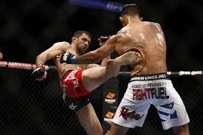
405.05 LESS LETHAL FORCE
1. Physical Force (Hands On) – Physical force is to be used to subdue unruly inmates, to separate inmates fighting, and in defense of self or others. It may also be employed to move inmates who fail to comply with lawful orders. Includes certain self-defense and inmate control techniques or strikes to areas of the body unlikely to result in serious physical injury.
Notes:
1. Physical Force (Hands On) – Physical force is to be used to subdue unruly inmates, to separate inmates fighting, and in defense of self or others. It may also be employed to move inmates who fail to comply with lawful orders. Includes certain self-defense and inmate control techniques or strikes to areas of the body unlikely to result in serious physical injury.

Slide 47
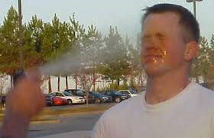
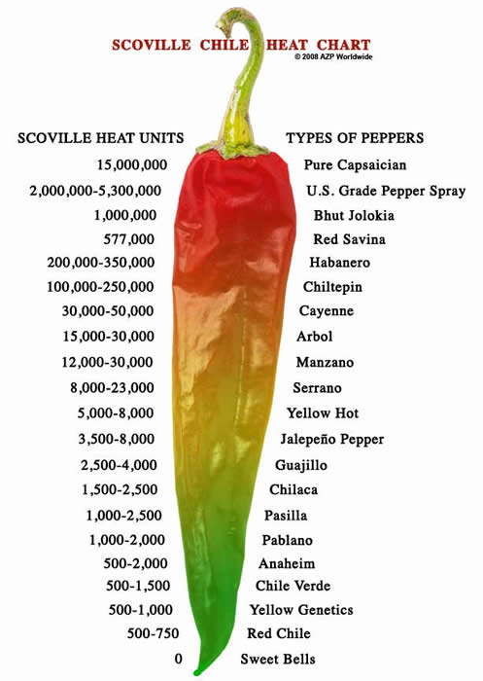
405.05 LESS LETHAL FORCE
2. Chemical / Inflammatory agents may be deployed only by trained and qualified Authorized Personnel. Chemical agents items such as listed below are designed to temporarily immobilize or incapacitate the inmate through temporary discomfort caused by a chemical action.

Slide 48
405.05 LESS LETHAL FORCE
CS - Ortho-chlorobenzalmalononitrile – commonly known as tear gas or mace
OC - Oleoresin Capsicum – commonly known as pepper spray
Notes:
CS - Ortho-chlorobenzalmalononitrile – commonly known as tear gas or mace
OC - Oleoresin Capsicum – commonly known as pepper spray

Slide 49
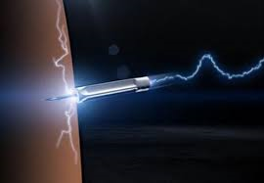
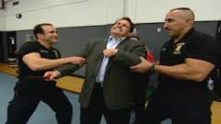
405.05 LESS LETHAL FORCE
3. Electronic Control Devices (ECD), to include items such as a Taser/electronic stun gun, Remote Access Custody Control (RACC) Belt, or electronic shield, are designated to temporarily immobilize or incapacitate an inmate by delivering a non-lethal electronic charge. An ECD may only be deployed by trained and qualified Authorized Personnel.
Notes:
Specialty Impact Devices (SID) Side handle batons or Expandable Baton or similar equipment designed to temporarily incapacitate an inmate by striking or applying a controlled take down of the inmate. These SID’s may only be used by trained and qualified Authorized Personnel.

Slide 50
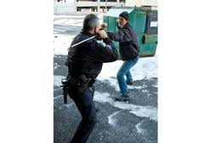
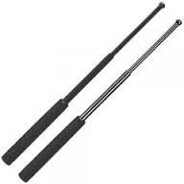
405.05 LESS LETHAL FORCE
4. Specialty Impact Devices (SID) Side handle batons or Expandable Baton or similar equipment designed to temporarily incapacitate an inmate by striking or applying a controlled take down of the inmate. These SID’s may only be used by trained and qualified Authorized Personnel.
Notes:
4. Specialty Impact Devices (SID) Side handle batons or Expandable Baton or similar equipment designed to temporarily incapacitate an inmate by striking or applying a controlled take down of the inmate. These SID’s may only be used by trained and qualified Authorized Personnel.

Slide 51
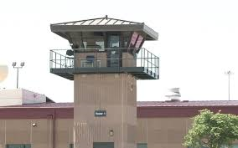
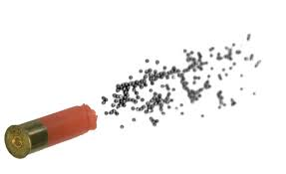
405.05 LESS LETHAL FORCE
5. A 12-gauge shotgun loaded with a blank round, a rubber stinger round and 7.5 birdshot rounds to skip shoot into the inmate(s) striking the inmate(s) in their lower extremities to temporarily incapacitate or immobilize the inmate(s). Shotguns may only be used by trained and qualified Authorized Personnel.
Notes:
A 12-gauge shotgun loaded with a blank round, a rubber stinger round and 7.5 birdshot rounds to skip shoot into the inmate(s) striking the inmate(s) in their lower extremities to temporarily incapacitate or immobilize the inmate(s). Shotguns may only be used by trained and qualified Authorized Personnel.

Slide 52
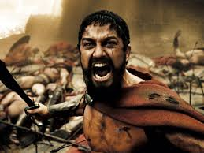
405.05 LESS LETHAL FORCE
A. A 12-gauge shotgun loaded with a blank round, a rubber stinger round and 7.5 birdshot rounds to skip shoot into the inmate(s) striking the inmate(s) in their lower extremities to temporarily incapacitate or immobilize the inmate(s). Shotguns may only be used by trained and qualified Authorized Personnel.
Notes:
A 12-gauge shotgun loaded with a blank round, a rubber stinger round and 7.5 birdshot rounds to skip shoot into the inmate(s) striking the inmate(s) in their lower extremities to temporarily incapacitate or immobilize the inmate(s). Shotguns may only be used by trained and qualified Authorized Personnel.

Slide 53
405.05 LESS LETHAL FORCE
C. If the initial warning shot fails to stop the prohibited activity, then a rubber stinger may be discharged skip shot towards the inmates.
D. If the rubber stinger round fails to stop prohibited activity, then 7.5 bird shot rounds may be skip shot into the ground/floor at the problem inmates.
Caution: If there is no ability to skip shoot into the ground/floor, then live rounds will NOT be discharged unless the inmate possesses a deadly weapon or serious physical injury and/or death is imminent. In this instance refer to 405.06.
Notes:
If the initial warning shot fails to stop the prohibited activity, then a rubber stinger may be discharged skip shot towards the inmates.
If the rubber stinger round fails to stop prohibited activity, then 7.5 bird shot rounds may be skip shot into the ground/floor at the problem inmates.
Caution: If there is no ability to skip shoot into the ground/floor, then live rounds will NOT be discharged unless the inmate possesses a deadly weapon or serious physical injury and/or death is imminent. In this instance refer to 405.06.

Slide 54
405.05 LESS LETHAL FORCE
E. The progression from the warning shot to the rubber stinger round and 7.5 birdshot will be dictated by the level of the threat.
1. Firing of a warning shot: If the conduct or activity does not stop then you can progress to firing of the Rubber Stinger round (skip shot).
Notes:
The progression from the warning shot to the rubber stinger round and 7.5 birdshot will be dictated by the level of the threat.
Firing of a warning shot: If the conduct or activity does not stop then you can progress to firing of the Rubber Stinger round (skip shot).

Slide 55
405.05 LESS LETHAL FORCE
2. If the threat increases to include;
More than two aggressors involved
Persons being over taken to the point where serious physical injury and/or death is imminent
Groups of inmates forming and being non-compliant
3. You can then progress to firing of the 7.5 birdshot. Skip shot only.
F. No less lethal force should be used to stop verbal abuse or other non-threatening behavior.
Notes:
If the threat increases to include;
More than two aggressors involved
Persons being over taken to the point where serious physical injury and/or death is imminent
Groups of inmates forming and being non-compliant
You can then progress to firing of the 7.5 birdshot. Skip shot only.
No less lethal force should be used to stop verbal abuse or other non-threatening behavior.

Slide 56
405.06 AUTHORIZATION FOR USE OF DEADLY FORCE
Staff have the obligation and responsibility to exercise discipline, caution, restraint and good judgment when using potentially deadly force. Deadly force may be used upon the reasonable belief that staff life or safety, or the life or safety of another, is in imminent danger of death or serious physical injury, given the totality of the circumstances known to the officer at the time of his/her action. Staff must keep in mind that the use of potentially deadly force presents a danger to the subject and to innocent parties. Only trained and qualified staff are authorized to use deadly force, and only as a last resort.
Notes:
Staff have the obligation and responsibility to exercise discipline, caution, restraint and good judgment when using potentially deadly force. Deadly force may be used upon the reasonable belief that staff life or safety, or the life or safety of another, is in imminent danger of death or serious physical injury, given the totality of the circumstances known to the officer at the time of his/her action. Staff must keep in mind that the use of potentially deadly force presents a danger to the subject and to innocent parties. Only trained and qualified staff are authorized to use deadly force, and only as a last resort.

Slide 57
405.06 AUTHORIZATION FOR USE OF DEADLY FORCE
Officers should consider other reasonable means of control before resorting to the use of deadly force as time and circumstances safely permit.
Deadly force is that degree of force which is likely to result in death or serious physical injury. Deadly force may be used only in the following situations:
Notes:
Officers should consider other reasonable means of control before resorting to the use of deadly force as time and circumstances safely permit.
Deadly force is that degree of force which is likely to result in death or serious physical injury. Deadly force may be used only in the following situations:

Slide 58
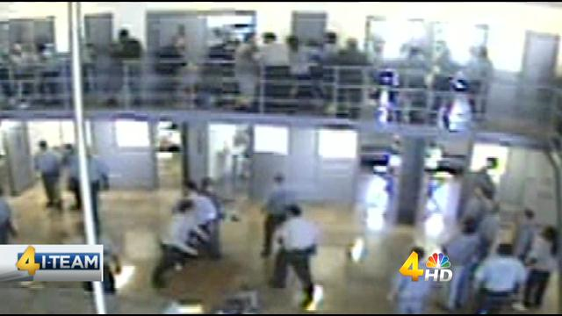
405.06 AUTHORIZATION FOR USE OF DEADLY FORCE
1. To prevent death or serious physical injury to self, other staff, inmates, or other persons who are threatened;
Notes:
1. To prevent death or serious physical injury to self, other staff, inmates, or other persons who are threatened;

Slide 59
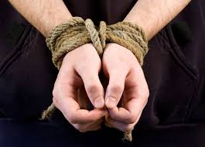
405.06 AUTHORIZATION FOR USE OF DEADLY FORCE
2. To prevent the taking of hostages;
Notes:
2. To prevent the taking of hostages;

Slide 60
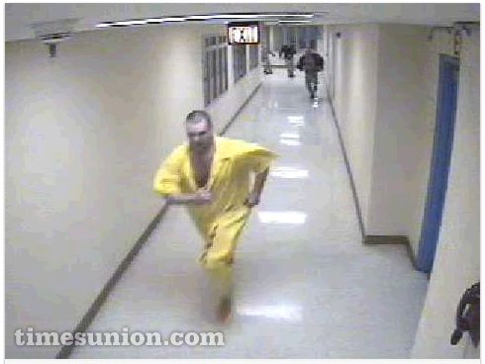
405.06 AUTHORIZATION FOR USE OF DEADLY FORCE
3. To prevent the escape of any prisoner from a medium security or higher correctional facility including while being transported or being housed in the community;
Notes:
3. To prevent the escape of any prisoner from a medium security or higher correctional facility including while being transported or being housed in the community;

Slide 61
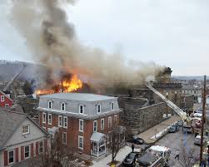
405.06 AUTHORIZATION FOR USE OF DEADLY FORCE
4. To prevent major damage during a disturbance within a facility if it is reasonably believed that the damage may cause death or serious physical injury to any person.
Notes:
4. To prevent major damage during a disturbance within a facility if it is reasonably believed that the damage may cause death or serious physical injury to any person.

Slide 62
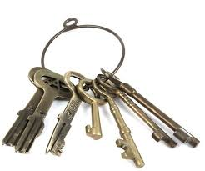
405.06 AUTHORIZATION FOR USE OF DEADLY FORCE
5. To prevent inmates from unlocking other inmates (seizure of keys or door controls).
Notes:
5. To prevent inmates from unlocking other inmates (seizure of keys or door controls).

Slide 63
405.06 AUTHORIZATION FOR USE OF DEADLY FORCE
6. If deadly force is to be used, staff will take reasonable actions under the following guidelines:
Time permitting a clear, verbal warning order, “stop or I will shoot,” will be given before each shot is discharged.
Notes:
6. If deadly force is to be used, staff will take reasonable actions under the following guidelines:
Time permitting a clear, verbal warning order, “stop or I will shoot,” will be given before each shot is discharged.

Slide 64
405.06 AUTHORIZATION FOR USE OF DEADLY FORCE
7. When the use of deadly force is warranted, if time and circumstances permit, a warning shot will be discharged.
A. In any life-threatening situation where the inmate does possess a deadly weapon or serious physical injury and/or death is imminent, the policy will be to “shoot to stop” by shooting at a vital portion of the body, such as the torso.
B. Every effort should be made to direct the round into the aggressor and not the victim.
C. If doubt exists in the officer’s mind as to whether he should discharge the firearm under the circumstances that have been outlined above, the officer should conclude that he SHOULD NOT discharge the firearm.
Notes:
7. When the use of deadly force is warranted, if time and circumstances permit, a warning shot will be discharged.
A. In any life-threatening situation where the inmate does possess a deadly weapon or serious physical injury and/or death is imminent, the policy will be to “shoot to stop” by shooting at a vital portion of the body, such as the torso.
B. Every effort should be made to direct the round into the aggressor and not the victim.
C. If doubt exists in the officer’s mind as to whether he should discharge the firearm under the circumstances that have been outlined above, the officer should conclude that he SHOULD NOT discharge the firearm.

Slide 65
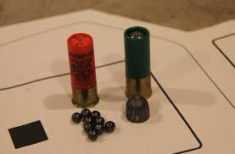
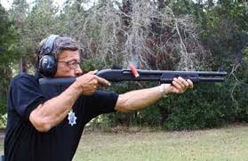
405.07 DEADLY FORCE
1. 12-gauge shotgun loaded with (00) buckshot rounds, or 7.5 birdshot when discharged directly at the inmate(s). May only be used by trained and qualified Authorized Personnel.
Notes:
1. 12-gauge shotgun loaded with (00) buckshot rounds, or 7.5 birdshot when discharged directly at the inmate(s). May only be used by trained and qualified Authorized Personnel.

Slide 66
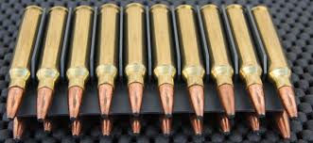
405.07 DEADLY FORCE
2. Mini 14 .223 caliber rifle loaded with 55 grain soft point rounds. May only be used by trained and qualified Authorized Personnel.
Notes:
2. Mini 14 .223 caliber rifle loaded with 55 grain soft point rounds. May only be used by trained and qualified Authorized Personnel.

Slide 67
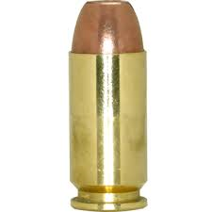
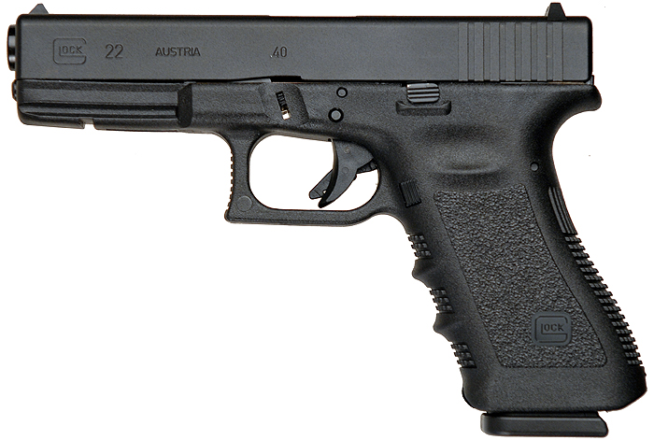
405.07 DEADLY FORCE
3. .40 caliber Glock semi-automatic hand gun loaded with hollow point 165 to 180 grain round – approved through FBI protocols/specifications. May only be used by trained and qualified Authorized Personnel.
Notes:
.40 caliber Glock semi-automatic hand gun loaded with hollow point 165 to 180 grain round – approved through FBI protocols/specifications. May only be used by trained and qualified Authorized Personnel.

Slide 68
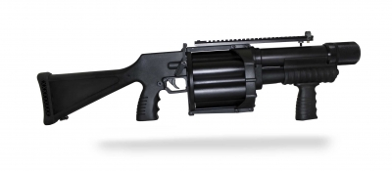
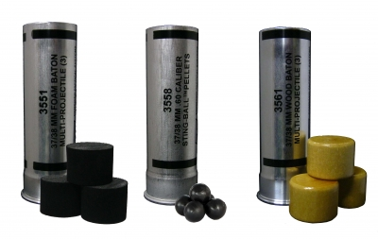
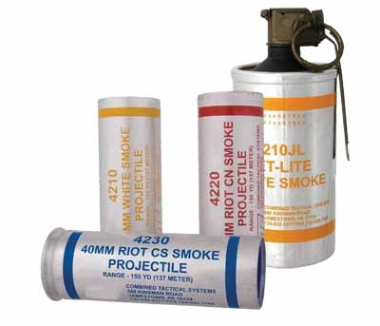
405.07 DEADLY FORCE
4. Specialized weapons may be authorized for emergency situations with approval from the Director/designee. May only be used by trained and qualified Authorized Personnel. Refer to Administrative Regulation (AR) 412 Armory Weapons and Control, for descriptions of authorized weapons, munitions and less lethal equipment.
Notes:
4. Specialized weapons may be authorized for emergency situations with approval from the Director/designee. May only be used by trained and qualified Authorized Personnel. Refer to Administrative Regulation (AR) 412 Armory Weapons and Control, for descriptions of authorized weapons, munitions and less lethal equipment.

Slide 69
405.08 ESCAPE FROM SECURED PERIMETER
1. If possible, prior to using firearms, attempts should be made to apprehend or physically restrain an escapee or an attempted escapee.
2. If an officer observes an inmate located within the "No Man's Land," an immediate alarm will be sounded to initiate a response then the following command in a loud and firm voice, will be given, "Stop or I will shoot." If the inmate fails to stop and no other means of stopping the inmate is available, then the officer may fire a warning shot as outlined in this procedure.
Notes:
1. If possible, prior to using firearms, attempts should be made to apprehend or physically restrain an escapee or an attempted escapee.
2. If an officer observes an inmate located within the "No Man's Land," an immediate alarm will be sounded to initiate a response then the following command in a loud and firm voice, will be given, "Stop or I will shoot." If the inmate fails to stop and no other means of stopping the inmate is available, then the officer may fire a warning shot as outlined in this procedure.

Slide 70
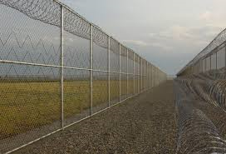
405.08 ESCAPE FROM SECURED PERIMETER
3. If the inmate continues toward the inner perimeter fence, after verbal warnings and a warning shot has been discharged, additional warning shots may be discharged near the escaping inmate in an effort to gain compliance. The officer must exercise care to prevent a possible ricochet of the warning shots. (Wardens will designate in operations procedures where warning shots will be discharged.)
Notes:
3. If the inmate continues toward the inner perimeter fence, after verbal warnings and a warning shot has been discharged, additional warning shots may be discharged near the escaping inmate in an effort to gain compliance. The officer must exercise care to prevent a possible ricochet of the warning shots. (Wardens will designate in operations procedures where warning shots will be discharged.)

Slide 71
405.08 ESCAPE FROM SECURED PERIMETER
4. Once an inmate has begun going over, under, or through the inner perimeter fence, (that is, feet have left the ground or crawling under or through), the following will be done:
A. The officer, after firing a warning shot, will “shoot to stop.”
B. The officer will choose which firearm to use based on distance and conditions surrounding the incident. The perimeter towers have both 12 gauge shotguns with .00 buckshot and .223 Mini-14 rifles designed for greater distance and accuracy.
Effective ranges:
.223 caliber round - up to 1000 yards
00 buckshot - up to 150 yards
Notes:
4. Once an inmate has begun going over, under, or through the inner perimeter fence, (that is, feet have left the ground or crawling under or through), the following will be done:
A. The officer, after firing a warning shot, will “shoot to stop.”
B. The officer will choose which firearm to use based on distance and conditions surrounding the incident. The perimeter towers have both 12 gauge shotguns with .00 buckshot and .223 Mini-14 rifles designed for greater distance and accuracy.
Effective ranges:
.223 caliber round - up to 1000 yards
00 buckshot - up to 150 yards

Slide 72
405.08 ESCAPE FROM SECURED PERIMETER
5. Should the situation arise in which the inmate attempting to escape is not noticed until after clear­ing the inner perimeter fence, the officer will fire one (1) warning shot if, in their opinion, there is still sufficient time to be able to “shoot to stop” before the inmate could clear the outer perimeter fence. If there is not enough time for a warning shot after the inmate has cleared the inner fence, then shots may be discharged directly at the escaping inmates to shoot to stop.
Notes:
5. Should the situation arise in which the inmate attempting to escape is not noticed until after clear­ing the inner perimeter fence, the officer will fire one (1) warning shot if, in their opinion, there is still sufficient time to be able to “shoot to stop” before the inmate could clear the outer perimeter fence. If there is not enough time for a warning shot after the inmate has cleared the inner fence, then shots may be discharged directly at the escaping inmates to shoot to stop.

Slide 73
405.09 USE OF FORCE IN THE COMMUNITY
1. There are numerous situations that call for Department personnel to provide escort and security functions in the community. Inmates may be transported to outside medical facilities, between institutions/facilities, into courtrooms for judicial proceedings or to a variety of other locations. Use of Force in the community calls for exercising extreme caution and for making careful judgments. The level of force utilized in any particular situation MUST be based largely on the physical surroundings and the proximity of civilians.
Notes:
1. There are numerous situations which call for Department personnel to provide escort and security functions in the community. Inmates may be transported to outside medical facilities, between institutions/facilities, into courtrooms for judicial proceedings or to a variety of other locations. Use of force in the community calls for exercising extreme caution and for making careful judgments. The level of force utilized in any particular situation must be based largely on the physical surroundings and the proximity of civilians.

Slide 74
405.09 USE OF FORCE IN THE COMMUNITY
2. The physical surroundings and proximity to civilians MUST be considered when an inmate is escaping during transport in an outside setting and if deadly force is necessary to prevent the inmate from escaping. If, in the best judgment of the transporting officer(s), it is deemed necessary to fire shots at the inmate escaping into the community, all shots will be directed at the inmates’ torso with the intent to completely stop the escape.
3. Officers are required to cooperate with local law enforcement officials in any unusual or emergency situation involving inmates under the custody of the Department of Corrections.
Notes:
2. The physical surroundings and proximity to civilians MUST be considered when an inmate is escaping during transport in an outside setting and if deadly force is necessary to prevent the inmate from escaping. If, in the best judgment of the transporting officer(s), it is deemed necessary to fire shots at the inmate escaping into the community, all shots will be directed at the inmates’ torso with the intent to completely stop the escape.
3. Officers are required to cooperate with local law enforcement officials in any unusual or emergency situation involving inmates under the custody of the Department of Corrections.

Slide 75
405.10 Medical Care After Use of Force
A. Medical care which includes medical treatment and examinations will be conducted by institutional medical staff when a Use of Force incident has occurred. When order has been restored, the inmate(s) who has been subjected to any Use of Force will be examined by medical staff and provided medical care proportionate to the individual’s injuries sustained. This examination will be documented utilizing the Unusual Occurrence Report form DOC 2514. All refusals of medical treatment will be documented and included in the Use of Force incident files utilizing the Refusal of Medical Treatment form DOC 2523.
Notes:
A. Medical care which includes medical treatment and examinations will be conducted by institutional medical staff when a Use of Force incident has occurred. When order has been restored, the inmate(s) who has been subjected to any Use of Force will be examined by medical staff and provided medical care proportionate to the individual’s injuries sustained. This examination will be documented utilizing the Unusual Occurrence Report form DOC 2514. All refusals of medical treatment will be documented and included in the Use of Force incident files utilizing the Refusal of Medical Treatment form DOC 2523

Slide 76
405.10 Medical Care After Use of Force
B. Any staff member involved in the Use of Force sustaining injuries will be examined by NDOC medical staff and will provide emergency medical care proportionate to the individual’s injuries prior to transport to an appropriate healthcare facility. This examination will be documented utilizing the Unusual Occurrence Report form DOC 2514.
Notes:
B. Any staff member involved in the Use of Force sustaining injuries will be examined by NDOC medical staff and will provide emergency medical care proportionate to the individual’s injuries prior to transport to an appropriate healthcare facility. This examination will be documented utilizing the Unusual Occurrence Report form DOC 2514.

Slide 77
405.11 Reporting of Use of Force
In all cases the reporting of Uses of Force MUST be accomplished as soon as practical after the incident and before leaving the institution or going off duty. Any Use of Force will be reported to the shift supervisors who will ensure, once order has been restored and the involved inmate(s) are placed in secure housing, that written reports from all staff involved are completed. This includes custody officers, institutional staff, medical staff, volunteers or any persons that witnessed the Use of Force.
Notes:
In all cases the reporting of Uses of Force MUST be accomplished as soon as practical after the incident and before leaving the institution or going off duty. Any Use of Force will be reported to the shift supervisors who will ensure, once order has been restored and the involved inmate(s) are placed in secure housing, that written reports from all staff involved are completed. This includes custody officers, institutional staff, medical staff, volunteers or any persons that witnessed the Use of Force.

Slide 78
405.11 REPORTING OF USE OF FORCE
1. These reports will be entered into the Nevada Offender Tracking Information System (NOTIS) for review by the appropriate supervisors.
A. All relevant and supporting documentation and information associated with the Use of Force will be contained within the NOTIS Incident Report (IR).
B. All relevant incident questions, inmate involvement questions, and staff involvement questions will be completed within NOTIS.
2. Verbal notification of the Use of Force will be made via the chain of command to the Warden. The Warden will notify the Deputy Director of Operations.
Notes:
1. These reports will be entered into the Nevada Offender Tracking Information System (NOTIS) for review by the appropriate supervisors.
A. All relevant and supporting documentation and information associated with the Use of Force will be contained within the NOTIS Incident Report (IR).
B. All relevant incident questions, inmate involvement questions, and staff involvement questions will be completed within NOTIS.
2. Verbal notification of the Use of Force will be made via the chain of command to the Warden. The Warden will notify the Deputy Director of Operations.

Slide 79
405.11 REPORTING OF USE OF FORCE
3. An email will be generated by the shift supervisor, notifying institutional/facility administration, the Deputy Director of Operations, and the Inspector General of the IR number and Use of Force for instances that involve, (the below referenced list includes but is not limited to the following uses of force that must be reported):
A. Discharge of a firearm for any reason other than training;
B. Any use of force that results in an injury to staff or an inmate;
C. Any use of force that results in an allegation or grievance claiming an injury;
D. Any complaint, grievance or indication of an unnecessary or excessive use of force; or
E. Planned use of force that results in any of the above.
Notes:
3. An email will be generated by the shift supervisor, notifying institutional/facility administration, the Deputy Director of Operations, and the Inspector General of the IR number and Use of Force for instances that involve, (the below referenced list includes but is not limited to the following uses of force that must be reported):
A. Discharge of a firearm for any reason other than training;
B. Any use of force that results in an injury to staff or an inmate;
C. Any use of force that results in an allegation or grievance claiming an injury;
D. Any complaint, grievance or indication of an unnecessary or excessive use of force; or
E. Planned use of force that results in any of the above.

Slide 80
405.12 USE OF FORCE INCIDENT REVIEWS
1. Any use of force suspected to be excessive or unnecessary will be immediately referred to and assigned to the Inspector General for investigation.
2. Any use of less lethal force will result in a Use of Force Review panel convening within ten (10) days from the use of force. The review panel will be comprised of staff not directly involved in the incident to ensure a fair and impartial review.
3. At a minimum the review panel will consist of:
A. An Associate Warden from the institution involved.
B. An institutional command staff at a level of authority of a Correctional Lieutenant or above, from the institution involved.
Notes:
1. Any use of force suspected to be excessive or unnecessary will be immediately referred to and assigned to the Inspector General for investigation.
2. Any use of less lethal force will result in a Use of Force Review panel convening within ten (10) days from the use of force. The review panel will be comprised of staff not directly involved in the incident to ensure a fair and impartial review.
3. At a minimum the review panel will consist of:
A. An Associate Warden from the institution involved.
B. An institutional command staff at a level of authority of a Correctional Lieutenant or above, from the institution involved.

Slide 81
405.12 USE OF FORCE INCIDENT REVIEWS
4. The review panel will review all information, reports, all video footage, and any other pertinent information or documents that are or will become available.
5. The review panel will review the actions of all staff members and inmate(s) involved in the use of force incident, including those actions leading up to the use of force, taking into account any Nevada Offender Tracking Information System (NOTIS) incident reports surrounding the time frame of the use of force, especially involving the staff member that used the force and the inmate that had the force used upon their person.
Notes:
4. The review panel will review all information, reports, all video footage, and any other pertinent information or documents that are or will become available.
5. The review panel will review the actions of all staff members and inmate(s) involved in the use of force incident, including those actions leading up to the use of force, taking into account any Nevada Offender Tracking Information System (NOTIS) incident reports surrounding the time frame of the use of force, especially involving the staff member that used the force and the inmate that had the force used upon their person.

Slide 82
405.12 USE OF FORCE INCIDENT REVIEWS
6. The review panel will conduct in person, recorded interviews of all staff and inmate(s) involved in the Use of Force. Should the panel, as part of the review, desire to question/interview an employee involved in the use of force, the panel will conduct all interviews in accordance with department disciplinary procedures, as well as relevant provisions of NRS chapter 284 and 289. The panel does not have the authority to recommend discipline.
Notes:
6. The review panel will conduct in person, recorded interviews of all staff and inmate(s) involved in the Use of Force. Should the panel, as part of the review, desire to question/interview an employee involved in the use of force, the panel will conduct all interviews in accordance with department disciplinary procedures, as well as relevant provisions of NRS chapter 284 and 289. The panel does not have the authority to recommend discipline.

Slide 83
405.12 USE OF FORCE INCIDENT REVIEWS
7. The review panel will evaluate the Use of Force incident and prepare a written report on its evaluation and determination to the Warden, the Deputy Director of Operations and Inspector General within ten (10) days from commencement of the Use of Force review, to include:
A. Was the Use of Force justified;
B. Was the Use of Force within policy, procedures and training of the Department;
C. Could the Use of Force have been prevented;
D. Could this type of Use of Force be prevented in the future;

Slide 84
405.12 USE OF FORCE INCIDENT REVIEWS
E. Any referral for investigation for possible disciplinary action for staff member(s) involved in the Use of Force.
F. Any recommended corrective action for staff member(s) involved in the use of force.
G. Any recommendation for any staff member that acted with distinction in the Use of Force; and
H. Any recommended changes or enhancements to policy, procedure, or training related to this Use of Force.
Notes:
Any referral for investigation for possible disciplinary action for staff member(s) involved in the Use of Force.
Any recommended corrective action for staff member(s) involved in the use of force.
Any recommendation for any staff member that acted with distinction in the Use of Force; and
Any recommended changes or enhancements to policy, procedure, or training related to this Use of Force.

Slide 85
405.13 SERIOUS USE OF FORCE INCIDENT REVIEWS
1. Any Use of Force suspected to be excessive or unnecessary will be immediately referred to and assigned to the Inspector General for investigation. In these circumstances the Use of Force Incident Review will not be completed.
Notes:
Any Use of Force suspected to be excessive or unnecessary will be immediately referred to and assigned to the Inspector General for investigation. In these circumstances the Use of Force Incident Review will not be completed.

Slide 86
405.13 SERIOUS USE OF FORCE INCIDENT REVIEWS
2. Any use of deadly force or less lethal force causing serious physical injury will result in convening a Serious Incident Review Panel within fifteen (15) days from the Use of Force. The review panel will be comprised of staff not directly involved in the incident to ensure a fair and impartial review.
Notes:
2. Any use of deadly force or less lethal force causing serious physical injury will result in convening a Serious Incident Review Panel within fifteen (15) days from the Use of Force. The review panel will be comprised of staff not directly involved in the incident to ensure a fair and impartial review.

Slide 87
405.13 SERIOUS USE OF FORCE INCIDENT REVIEWS
3. At a minimum the review panel will consist of:
A. A Warden and/or an Associate Warden from an institution where the use of force did not occur;
B. An Investigator or Supervisory Investigator from the Inspector General’s Office;
C. An institutional command staff at a level of authority of a Correctional Lieutenant or above, from an institution where the use of force did not occur.
Notes:
3. At a minimum the review panel will consist of:
A. A Warden and/or an Associate Warden from an institution where the use of force did not occur;
B. An Investigator or Supervisory Investigator from the Inspector General’s Office;
C. An institutional command staff at a level of authority of a Correctional Lieutenant or above, from an institution where the use of force did not occur.

Slide 88
405.13 SERIOUS USE OF FORCE INCIDENT REVIEWS
4. The review panel will review all information, reports, all video footage, and any other pertinent information or documents that are or will become available.
5. The review panel will review the actions of all staff members and inmate(s) involved in the use of force incident, including those actions leading up to the use of force, taking into account any Nevada Offender Tracking Information System (NOTIS) incident reports surrounding the time frame of the use of force, especially involving the staff member that used the force and the inmate that had the force used upon their person.
Notes:
4. The review panel will review all information, reports, all video footage, and any other pertinent information or documents that are or will become available.
5. The review panel will review the actions of all staff members and inmate(s) involved in the use of force incident, including those actions leading up to the use of force, taking into account any Nevada Offender Tracking Information System (NOTIS) incident reports surrounding the time frame of the use of force, especially involving the staff member that used the force and the inmate that had the force used upon their person.

Slide 89
405.13 SERIOUS USE OF FORCE INCIDENT REVIEWS
6. The review panel will conduct in person, recorded interviews of all staff and inmate(s) involved in the Use of Force. When the panel, questions/interviews a staff member involved in the Use of Force the panel will conduct all interviews in accordance with department disciplinary procedures, as well as relevant provisions of NRS chapter 284 and 289. The panel does not have the authority to recommend discipline.
Notes:
6. The review panel will conduct in person, recorded interviews of all staff and inmate(s) involved in the Use of Force. When the panel, questions/interviews a staff member involved in the Use of Force the panel will conduct all interviews in accordance with department disciplinary procedures, as well as relevant provisions of NRS chapter 284 and 289. The panel does not have the authority to recommend discipline.

Slide 90
405.13 SERIOUS USE OF FORCE INCIDENT REVIEWS
A. The written notice will provide the names of the assigned staff members to the review panel;
B. The written notice will identify the NOTIS Incident Number for the Use of Force incident;
C. The written notice will identify the date, time and location of the interview;
D. The review panel will ask questions and gather information related to the specific Use of Force, the inmate(s) involvement and any historical information related to the interaction between the involved staff member and the involved inmate(s);
E. The written notice will provide the Notice of Confidentiality applied to the Use of Force Review.
Notes:
A. The written notice will provide the names of the assigned staff members to the review panel;
B. The written notice will identify the NOTIS Incident Number for the Use of Force incident;
C. The written notice will identify the date, time and location of the interview;
D. The review panel will ask questions and gather information related to the specific Use of Force, the inmate(s) involvement and any historical information related to the interaction between the involved staff member and the involved inmate(s);
E. The written notice will provide the Notice of Confidentiality applied to the Use of Force Review.

Slide 91
405.13 SERIOUS USE OF FORCE INCIDENT REVIEWS
7. The review panel will evaluate the Use of Force incident and prepare a written report on its evaluation and determination to the Director and the Deputy Director of Operations within thirty (30) days from commencement of the Use of Force review, to include:
A. Was the Use of Force justified;
B. Was the Use of Force within policy, procedures and training of the Department;
C. Could the Use of Force have been prevented;
Notes:
7. The review panel will evaluate the Use of Force incident and prepare a written report on its evaluation and determination to the Director and the Deputy Director of Operations within thirty (30) days from commencement of the Use of Force review, to include:
A. Was the Use of Force justified;
B. Was the Use of Force within policy, procedures and training of the Department;
C. Could the Use of Force have been prevented;

Slide 92
405.13 SERIOUS USE OF FORCE INCIDENT REVIEWS
D. Could this type of Use of Force be prevented in the future;
E. Any referral for investigation for possible disciplinary action for staff member(s) involved in the Use of Force.
F. Any referral for investigation for possible corrective action for staff member(s) involved in the Use of Force.
G. Any recommendation for any staff member that acted with distinction in the Use of Force; and
H. Any recommended changes or enhancements to policy, procedure, or training related to this Use of Force.
Notes:
D. Could this type of Use of Force be prevented in the future;
E. Any referral for investigation for possible disciplinary action for staff member(s) involved in the Use of Force.
F. Any referral for investigation for possible corrective action for staff member(s) involved in the Use of Force.
G. Any recommendation for any staff member that acted with distinction in the Use of Force; and
H. Any recommended changes or enhancements to policy, procedure, or training related to this Use of Force.

Slide 93
405.13 SERIOUS USE OF FORCE INCIDENT REVIEWS
8. Any recommended corrective action being applied to a staff member will be reported to the appointing authority via a memorandum that outlines the reason for the corrective action. A corrective action is not deemed a discipline.
9. Any findings that recommend disciplinary action be taken against a staff member will be referred to the Inspector General and Director for their review and appropriate response; response may include, but not be limited to official assignment for Administrative Investigation.
Notes:
8. Any recommended corrective action being applied to a staff member will be reported to the appointing authority via a memorandum that outlines the reason for the corrective action. A corrective action is not deemed a discipline.
9. Any findings that recommend disciplinary action be taken against a staff member will be referred to the Inspector General and Director for their review and appropriate response; response may include, but not be limited to official assignment for Administrative Investigation.

Slide 94
405.13 SERIOUS USE OF FORCE INCIDENT REVIEWS
10. Any findings that recommend a change or enhancement to a policy, procedure, or training will be sent to the Director and Deputy Director of Operations.
11. Any findings that identifies that a staff member acted with distinction in the Use of Force will be sent to the Director and Deputy Director of Operations.
Notes:
10. Any findings that recommend a change or enhancement to a policy, procedure, or training will be sent to the Director and Deputy Director of Operations.
11. Any findings that identifies that a staff member acted with distinction in the Use of Force will be sent to the Director and Deputy Director of Operations.

Slide 95
405.13 SERIOUS USE OF FORCE INCIDENT REVIEWS
12. The review panel report and its contents are confidential and not subject to dissemination except by order of the Director, Inspector General, or lawful court order.
13. The Inspector General’s Office will track all Use of Force reviews to insure timely completeness. The Inspector General’s Office will prepare and submit to the Director’s executive team, an annual report that details the number of Uses of Force that were reviewed and the total of the outcomes for each of the categories reviewed
Notes:
12. The review panel report and its contents are confidential and not subject to dissemination except by order of the Director, Inspector General, or lawful court order.
13. The Inspector General’s Office will track all Use of Force reviews to insure timely completeness. The Inspector General’s Office will prepare and submit to the Director’s executive team, an annual report that details the number of Uses of Force that were reviewed and the total of the outcomes for each of the categories reviewed

Slide 96
405.14 OFFICER INVOLVED SHOOTING INVESTIGATIONS
1. All uses of force that involve the discharge of a firearm, excluding blank rounds, will result in an Officer Involved Shooting (OIS) investigation being done by an investigator(s) of the Inspector General’s Office (IG) unless;
A. A death occurs that is the result of the discharged round, at which time an outside law enforcement investigating body will be called in for response and investigation;
B. Director or Inspector General determines that the matter is or may be a conflict of interest to the Department.
Notes:
1. All uses of force that involve the discharge of a firearm, excluding blank rounds, will result in an Officer Involved Shooting (OIS) investigation being done by an investigator(s) of the Inspector General’s Office (IG) unless;
A. A death occurs that is the result of the discharged round, at which time an outside law enforcement investigating body will be called in for response and investigation;
B. Director or Inspector General determines that the matter is or may be a conflict of interest to the Department.

Slide 97
405.14 OFFICER INVOLVED SHOOTING INVESTIGATIONS
2. The processes and procedures used in conjunction with an OIS investigation and the subsequent report format will be contained within the confidential I.G. manual.
3. All OIS investigations are confidential and not subject to dissemination without the authorization of the Director, Inspector General, and Board of Prison Commissioner’s or in conjunction with lawfully issued court order.
4. The OIS report will be e-mailed to the Director, Deputy Director of Operations and the Inspector General/designee. Once approved, this report will be made available to the Use of Force Review Panels.
Notes:
2. The processes and procedures used in conjunction with an OIS investigation and the subsequent report format will be contained within the confidential I.G. manual.
3. All OIS investigations are confidential and not subject to dissemination without the authorization of the Director, Inspector General, and Board of Prison Commissioner’s or in conjunction with lawfully issued court order.
4. The OIS report will be e-mailed to the Director, Deputy Director of Operations and the Inspector General/designee. Once approved, this report will be made available to the Use of Force Review Panels.

Slide 98
USE OF FORCE SCENARIOS
Notes:
Refer to handout.

Slide 99
SCENARIO 1
Officer is working on a gun rail, one his duties include watching the Inmates on the recreation yard.
Officer sees two Inmates rush another Inmate on the yard punching him.
There is no other Officer in the vicinity of the fighting Inmates.
Officer yells at the Inmates to stop and get down on the ground.
Inmates ignore his orders and continue to assault the Inmate.
Officer again gives the verbal order to stop and get down or he will shot.
Inmates ignore his orders and continue to assault the Inmate.
Officer fire the blank round into the air, one of the aggressors stops and gets down. The Inmate being assaulted runs from the one aggressor who has not stopped assaulting him yet.
The one aggressor gives chase and continues the assault him in a new location.
Officer fire a second time, firing a skip shot with the stinger (rubber) round in the direction of the disturbance.
The aggressor was hit with the rubber pellets and stops his attack and get down on the ground as ordered.

Slide 100
SCENARIO 1 RESPONSES
Officer calls for assistance via his hand held radio. Level one response initiated.
Officer points out the Inmates involved in the incident to the responding Officers.
Inmates involved are placed in restraints on the ground where they ended up.
Incident commander arrives and takes charge of the scene and assigns someone to start recording the response with a hand held camera. Incident Commander with notify the Associate Warden and or the Warden that there was a live round fired. IG Office will be notified that there was a live round fired Location and time of the incident.
Once the scene is secure, the Incident commander will call for Medical to enter the scene.
Medical will check on all the Inmates involved and fill out an unusual occurrence on each of the Inmates involved. If medical clears the Inmate back to custody the Incident Commander will takes charge of the Inmates. While the Inmates are being seen by Medical Staff the Incident commander will starts to gather information about the incident. He’ll have the Officers Involved relieved so they can start their reports.

Slide 101
SCENARIO 1 RESPONSES
All three Inmates were cleared by Medical and returned to custody.
Incident Commander calls Central Control for available Segregation beds.
Inmates involved are moved to Segregation, Incident Commander calls the Unit where the Inmates were assigned to have their property inventoried and moved up to the Property Room.
Incident Commander now has the responding Officers Search and conduct body checks for any Inmates that may have been missed, who were involved but not identified as being involved. Once the remaining Inmates on the scene have been checked the Officers will check the area for evidence. Take pictures of anything of significance i.e. blood spatter weapons used etc.
The Incident Commander will initiate an Incident Report (IR) in NOTIS. Arrange to get the weapon fired and all expended round casings collected and replaced. Give the IR number to the Staff involved for their reports. Gather/print all the reports from the Officers involved and get them signed. Get copies of the Medical reports, property inventory sheets, Bed movement sheets, Notice of Classification change Sheets, Booking Sheets, gang information, and Notice of charges to be placed in the incident folder.
Once all the data is collected turn the completed packet to the warden for the incident review panel.

Slide 102
SCENARIO 2
Inmate in the Infirmary behavior, shadow boxing telling everybody who will listen to him that he the greatest boxer ever, is causing concern for his safety and or Staff safety.
Medical Staff evaluate the situation and get an order from the Doctor to give him some medication before he hurts himself or someone else.
The Inmate is taken out of his cell and escorted to the Nurses Station to receive the medication but, the Inmate refuses to allow the Nurse to give him the medication.
Now that the Inmate knows why he is out of the cell he becomes more frantic. The Officer places the Inmate into a nearby shower and secures the door.
Medical informs the Doctor who then signs a force medication order.
Medical notifies custody that the Doctor has order the medication be given.
Shift Supervisor (LT) and Associate Warden (AW) are notified of the problem.
AW and LT go to the Infirmary to talk with the Inmate and try to get him to take his medication. Inmate refuses.
AW tells the LT to get a team together for a plan use of force if necessary.

Slide 103
SCENARIO 2 RESPONSES
Lt. contacts the Correctional Emergency Response Team (CERT) and tells the Sergeant in charge what is going on in the Infirmary and for him to get a team ready for a possible cell extraction.
CERT Sergeant gathers a three man team for this task because of the Inmate is in a single shower and there is not a lot of room to work with. Any more than three men would be too many and less effective.
Inmate is still acting out. Attempts to get him to comply are still on going.
CERT Sergeant arrives with his team talks with the LT and AW for any updates. Nothing has changed the Doctor has signed the order for force medication and the Inmate needs to receive the medication.
CERT Sergeant starts the plan use of force. On camera away from the non-compliant Inmate he explains the situation, and gives the name and back number of the Inmate involved. He then has his team introduce themselves and report their responsibility during the extraction and if they have any injuries before they start.
Afterwards the CERT Sergeant conducts a controlled movement to the location of the Inmate.
CERT Sergeant talks to the Inmate and tells him that failure to comply will results in force being use against him to effect compliance. Inmate refuses to comply.

Slide 104
SCENARIO 2 RESPONSES
CERT Sergeant gives the Inmate three chances to comply. Inmate refuses to comply and moves to the back right corner of the shower and takes a defensive posture.
Sergeant tells his team back right corner and opens the door. CERT team goes into the shower first man with a shield to control the Inmate, second and third man enter and quickly get control of the Inmate’s extremities. Inmate is resisting and fights with the Officers.
Officers get enough control to pull him out of the shower and on him stomach in front of the shower. Inmate continues to resist. Officer fight to get control of his arms giving the Inmate orders to put his hands behind his back. Inmate resist by putting his arms under his stomach. Officers continue to fight for control of his arms by pulling on his upper arms to take control of the arm.
Officers, after several minutes of struggling with the Inmate, get control of his arm and legs and place him in restraints. Inmate was then carried back to his cell and laid on his stomach on the bed so that the medication could be administered. Medical staff was called in to administer the medication once the CERT team had full control of the Inmate.

Slide 105
SCENARIO 2 RESPONSES
Medical administered the medication and evaluated the Inmate for possible injuries due to being extracted from the shower area.
Medial Staff finishes and leaves the cell. CERT Sergeant tells the Inmate the restraints are going to be removed and instruct the Inmate to comply or force will be used to effect compliance. CERT Sergeant starts instructing his team through the process of unshackling the Inmate. Inmate legs restraints are removed first then the team picks the Inmate up off the bed and back him to the door. While holding onto the Inmate’s hands the door is manually closed with the food flap in the open position so the Officer controlling the Inmate’s hands can guide them through the food flap without injuring the Inmate.
Once the door is fully secured the Officer controlling the Inmate’s hands removed the wrist restraints and secures the food flap when the Inmate’s hands are clear.
CERT Sergeant gathers his team and lines them up in an area away from the Inmates for debrief and checks his team for possible injuries by asking the team member if they were injured in this incident. If there were no injuries the CERT Sergeant will on camera conclude the incident and stop the recording.
LT will initiate an Incident Report (IR) number in NOTIS for all the Officers involved reports. Give the IR number to the Officers involved so they can complete their reports. Collect the medical report from the Medical Staff. Gather/print the Officers involved reports and get them signed. Create an incident folder for all the data and turn in a completed report packet to the Warden for review.

Slide 106
SCENARIO 3
Approximately 30 Inmates were being staged for transportation to Ely State Prison from High Desert State Prison. One of the Inmates asked to use the restroom.
Officer opens the cage door to allow the Inmate access to the Inmate restroom across the room nearby.
The Inmate enters the restroom and closes the door.
Officer continues to work.
Inmate comes out of the rest room and runs up behind the Officer and punches him in the head.
Officer turns around and sees the inmate throwing another punch at him.
Officer deflects the punch and moves into the Inmate to get control.
Another Officer passing by notices the incident and rushes in to assist the Officer who is being attack by the Inmate.
Both Officers force the inmate down to the ground and get him in restraints.

Slide 107
SCENARIO 3
The Officer who was attacked by the Inmate calls via his hand held radio for a supervisor to come to his location code 4 (non-emergency) a spontaneous use of force has just occurred.
Supervisor (LT) calls for Medical to respond to the location.
LT responds to the area and noticed that Inmate was on the floor in restraints.
LT asks the Officer what happen and the Officer reported being struck in the head with a closed fist by the Inmate.
Lt had Medical evaluate the Officer and Inmate for possible injuries. Medical filled out an unusual occurrence on both of them.
Officer that was attack/assaulted filled out a C1 (report of employee injury) form.
Inmate was treated for minor cuts and scratches and was allowed to continue with his transportation to Ely State Prison.
LT will initiate an Incident Report (IR) number in NOTIS for the Officers involved reports. Give the IR number to the Officers involved so they can complete their reports. Collect the medical report from the Medical Staff. Gather/print the Officers involved reports and get them signed. Generate an OIC so the Officer can complete a Notice of Charges on the Inmate. Create an incident folder for all the data and turn in a completed report packet to the Warden for review.

Slide 108
SCENARIO 4
Culinary Fight Scenario: The culinary is full of inmates during feeding, culinary gun post is in the middle of the culinary against the north wall, elevated only 24 inches above the floor, metal culinary tables with inmates are located less than four (4) feet from the gun post. Two inmates begin fighting and refuse verbal commands. Gun post office is the only officer currently in the culinary.
The situation continues to develop, several inmates refuse to comply not getting down on the floor the aggressors continue to fight one is not gaining a distinct advantage over the other…

Slide 109
SCENARIO 4 RESPONSES
-What should the Culinary Gun post Officer do at this point?
Possible additional developments: One additional Officer arrives with OC spray, Impact Weapon (ASP).
A third Officer arrives with Taser.
Below is the actual situation Gus Post report from the incident (Names have been removed)

Slide 110
SCENARIO 4 I/R REPORT
DATE: AUGUST 4, 2015
TIME: 1642
LOCATION: WSCC CULINARY (DINNER FEEDING)
PERSPECTIVE: CULINARY GUN CAGE OFFICER
IR: 2015-WSCC-000436
WEAPON: REMMINGTON MODEL 870 12ga. SHOTGUN LOADED WITH 1 POPPER AND 3 RUBBER ROUNDS
DISTANCE: INMATES BEGAN FIGHTING APPROX. 35’ FROM THE GUN CAGE. DURING THE ALTERCATION, THEY MOVE TOWARD THE GUN CAGE, ENDING APPROX. 20’ FROM THE GUN CAGE.

Slide 111
SCENARIO 4 I/R REPORT
On August 4, 2015 I was assigned to the culinary gun post at Warm Springs Correctional Center during dinner feeding. At approximately 1642 I heard an Officer giving orders to stop fighting directed at two inmates who were involved in a physical altercation. I quickly turned my direction toward the right side of the culinary, to observe the incident. At that time I observed two inmates engaging in a physical altercation. I retrieved the Remington 870 shotgun and quickly issued several direct orders through the gun port to ‘Stop fighting get on the ground or I will shoot.’ I repeated issuing direct orders for the inmates to ‘stop fighting get on the ground or I will shoot.’ However, the inmates continued fighting and disregarded all my directives. Simultaneously, while I was issuing direct orders to stop fighting, I also was placing the barrel of the Remington shotgun in the gun port and discharged one blank popper round in a safe direction away from inmates or staff. The fighting inmates continued to refuse my direct orders and continued fighting each other.

Slide 112
SCENARIO 4 I/R REPORT
Once again I ordered the inmates to ‘stop fighting.’ Both inmates refused my orders and continued to physically assault each other so I then discharged one CTS less -lethal .31 cal. high velocity sting-ball Model 2553 round directly at the torso area of the fighting inmates. The inmates once again failed to follow my direct orders and continued to physically assault each other, refusing to obey all my verbal commands. After both inmates failed to follow my direct orders to stop fighting, I discharged a second CTS less-lethal .31 cal. high velocity sting-ball Model 2553 round at the torso area of both inmates fighting. Again, I issued another verbal command to both inmates to ‘stop fighting’ both inmates once again refused my orders and continued assaulting each other. It was necessary for me to discharge a third CTS less-lethal .31 cal. high velocity sting-ball Model 2553 round at the torso area of both inmates who continued to defy my orders and physically assault each other. After discharging a third CTS less-lethal .31 cal. high velocity sting-ball Model 2553 round at the fighting inmates, both inmates finally complied with my direct orders and stopped physically assaulting each other. Both inmates then laid on the floor of the culinary and were placed in wrist restraints by responding staff. Both inmates were immediately escorted to the infirmary and provided medical care for their injuries.

Slide 113
SCENARIO 5
Unit Fight Scenario: While working as the unit two officer, this is an older style unit three wings with the rotunda and control room in the center. While in the control room you see what appears to be an inmate fight involving several inmates and numerous inmates gathering around and inciting the fight. You are the only Custody staff in the unit; how do you respond?

Slide 114
SCENARIO 5 RESPONSES
Possible additional developments: One additional Officer arrives with OC spray, Impact Weapon (ASP). Inmates are running away from the fight and into other wings and cells.
You identify an involved inmate who is now in his cell that refuses to cooperate with your orders to turn around and be placed in restraints, what actions do you take?

Slide 115
SCENARIO 6
Yard Fight Scenario: While working in tower 2 at WSCC, you have a shot gun and Mini-14 rifle; you observe two inmates fighting on the recreation yard no weapons are involved and neither inmate has an advantage over the other, What actions do you take?
Possible additional developments: One inmate picks up a metal weight and is striking the and now has an obvious advantage and potential to create bodily harm; what actions do you take?

Slide 116
SCENARIO 7
Tower Scenario: While working in tower 2 at WSCC you have a shot gun and Mini-14 rifle, you observe what you believe to be an inmate on the outside of the perimeter fence running away from the prison, What actions do you take?
Possible additional developments: You observe what you believe to be a second inmate climbing over the top of the perimeter fence, What action do you take?

Slide 117
SCEANRIO 8
Escort Scenario: While Search and Escort at WSCC you are escorting an inmate in restraints to shift command for a disciplinary hearing; While walking across the yard the inmate becomes belligerent and twist away from you striking you with his shoulder and refuses to comply with your instructions; What actions do you take?
Possible additional developments: Other inmates begin to crowd you and incite other inmates; What action do you take?

Slide 118
SCENARIO 9
In December at NNCC several intake inmates are being escorted back to the intake unit (Unit 7) from the clinic Unit 8. There are several general population inmates in the pill call line at the time of the escort. The inmates in the pill call line are not complying with orders to move away from the escort.
What are your options at this point?
Is there a need for a use of force?
What could have been done to avoid this issue?

Slide 119
SCENARIO 10
You are a floor officer in the intake unit at NNCC. You are alerted that two inmates are fighting in their assigned cell. You respond to the cell and witness the inmates fighting through the cell door window. One inmate is getting the advantage and is starting to severely injure the other inmate.
What are your options at this point?
Is there a need for a use of force?
What tactics are available to you at this point?
What tools are available to you at this point?

Slide 120
SCEANRIO 11
You are assigned as the culinary gun post officer at NNCC. A fight breaks out between two inmates at the table closest to your post. The inmates are not complying with orders to stop fighting and lay on the ground.
What are your options at this point?
Is there a need for a use of force?
What tactics are available to you at this point?
What tools are available to you at this point?

Slide 121
SCENARIO 12
Sunday after 11:15 count 40 austere housing inmates on yard time in the front yard of unit 8:
Fight breaks out in front of unit 8. 5 type two inmates are assaulted by 12 type 3 inmates and are not responding to verbal commands. Inmates are not in sight of Gym Gun Post or in effective range of Tower One. Weapons are reported by the unit 8 staff. All other inmates are on the ground but are starting to get back up.

Slide 122
SCENARIO 13
Monday during feeding evening meal:
Culinary free staff reports a fight with 3 type 1 inmates and 4 type 2 inmates in the kitchen by the bakery. Culinary Officers respond along with Search and Escort. The inmates are not responding to any verbal commands given by the officer. One inmate is waving around a paddle that he was able to free from the cord. The inmates continue to fight as more officers are called to respond.

Slide 123
SCENARIO 14
Middle of day during outside recreation
The Tower #4 Officer called Main Control via radio and said that there is a fight (4-16) on the recreational yard, 3 inmates on the baseball field. Control announced Emergency traffic only, Search & Escort respond to incident. S&E and Gym Post Gun Officers order all inmates on the rec yard to get on the ground. Upon arrival to the baseball field, 2 inmates were attacking 1, which appeared the victim. S&E sprayed OC and pulled them apart. The 3 inmates were then placed wrist restraints. At that time approximately 12 inmates on the soccer field jumped up and started fighting. S&E called Control via radio for ‘B’ Responders to report to the main yard for assistance. One S&E stays with the restrained inmates and 2 responded to the soccer field. Inmates continued to fight, Gym Gun Post shot a warning Popper round, and they did not comply. While ‘B’ Responders began to arrive, multiple inmates ran from the handball court to the soccer field to join in the Riot. One Post then fired a Less Lethal stinger round. The round did not reach the incident on the soccer field and was not effective.

Slide 124
SCENARIO 15
Location: FMWCC - Recreational Yard
Time: 9:30 am
Staff Present: 1 Recreational Yard Officer
50 Inmates on Recreational Yard
Approximately 50 female inmates from Unit 1 are on the recreational yard. The Recreational Yard Officer observes approximately six (6) inmates gathered together and heard yelling from several of the inmates. As the officer was approaching the group of inmates, he was using verbal commands by telling the inmates to separate and cease yelling. As the officer was calling for assistance via his hand held radio, two of the inmates began to fight which resulted in both inmates being on the ground hitting and kicking each other. The Recreational Yard officer continued with verbal commands to stop fighting until assistance arrived. The Recreational Yard officer and one responding officer physically separated the two inmates that were fighting by placing their hands on the arms of the inmates and pulling them apart. Inmates were placed in wrist restraints in which they did not resist then escorted to the infirmary for medical assessment.

Slide 125
SCEANRIO 16
Location: JCC
Time: 6:15 pm
Staff Present: 1 Correctional Officers
At approximately 6:15 pm an inmate returning from NDF work site refused to comply with a unclothed body search and attempted to walk away from the Correctional Officers. The Correctional Officer requested assistance from the only other officer at the facility, then the Correctional Officer grabbed the inmate's arm to contain the inmate. The inmate became resistant by pulling her arm away from the officer when the Officer attempted to place her in wrist restraints. When the responding staff arrived on scene, the officer gave the inmate clear verbal commands to stop resisting. The inmate did stop resisting and complied when the wrist restraints were applied.

Slide 126
SCEANRIO 17
Location: FMWCC - Medical Department
Time: 10:45 pm
Staff Present: 1 Medical Officer and 1 Medical Nurse
At approximately 10:45 pm the medical officer observed an inmate housed within medical who was actively attempting to cut her wrists with a sharp object. The medical officer immediately called for custody and medical assistance. Upon awaiting for medical assistance, the medical officer verbally was ordering the inmate to stop cutting herself and to place the sharp object on the ground. Upon arrival of the responders, the inmate had placed the sharp object on the ground but refused to move to the back of the cell. Due to the medical needs of the inmates, the supervisor initiated a team of officers (with appropriate safety gear) to enter the cell and physically controlled the inmate's extremities so that medical staff could assess and provide treatment to the injuries.

Slide 127
COMMON SENSE
While we have provided numerous scenarios and discussed options in Use of Force there will always be a time that common sense and reasoning will be needed in a situation.
The preservation of life is our utmost concern in all Use of Force applications and proper care and concern must always be used in UOF situations.
Proper and complete reports and paperwork will always be submitted and completed after any UOF incident no matter how small.
Any questions should always be directed to your Supervisor for clarification.

Slide 128
QUESTIONS
??????????

