Slide 1
THE CRIMINAL JUSTICE SYSTEM
Presented by the Office of the Nevada Attorney General
Notes:
Welcome and introductions.

Slide 2
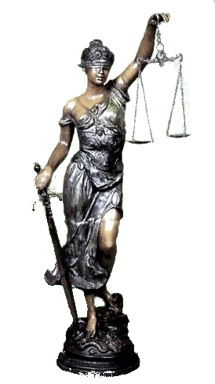
Lady Justice
Notes:
Lady justice: represents America’s legal system, each object is a symbol of some part of that system.
Scales: adversarial system (contrast with scientific method, learning from authority), weighing evidence.
Blindfold: objectivity, fairness (equality under the law, no favoritism).
Sword: power to enforce the law (courts have power to punish those who break the rules).

Slide 3
Today’s roadmap
Criminal justice system defined
Cast of characters
Police
Prosecutors and defense attorneys
Judges
Correctional officers/staff
Arrest to release: steps in the criminal justice system
Nevada courts
Classification of crimes and theories of punishment

Slide 4
Define: criminal justice system
The system of practices and institutions of governments directed at (1) upholding social control, (2) deterring and mitigating crime, and (3) sanctioning those who violate laws with criminal penalties and rehabilitation efforts.
--Wikipedia (the source of all truth and knowledge)
Notes:
Civil versus criminal: criminal and civil law may overlap and attempt to punish the same conduct (e.g., criminal and civil proceedings stemming from Nicole Brown Simpson murder). However, criminal conviction is moral condemnation, attempts to place blame on an individual for violating community standards.

Slide 5
Cast of characters: police
Maintain order
Prevent and detect crime
Arrest criminal suspects
Collect and preserve evidence for use at trial

Slide 6
Video clip: Chief Gunderson confronts Salesman Jerry
Notes:
Image: Frances McDormand as small-town Minnesota police chief Marge Gunderson in Fargo (1996).
Video clip background: Chief Gunderson, a local police chief who is seven months pregnant, is investigating a string of murders related to a car salesman who hired two thugs to kidnap his wife in a desperate attempt to obtain the ransom money. She correctly unravels the chain of events and follows the leads she discovers to a car dealership that employs the car salesman, played here by William H. Macy. In this scene, Chief Gunderson confronts her suspect with the evidence connecting him to the murders and confirms her suspicious that Jerry is involved.
Discussion: was this an effective police interview? What did she do right?

Slide 7
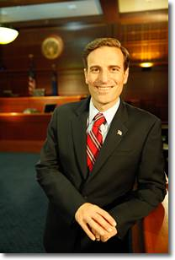
Cast of characters: the prosecutor
Types
District Attorney
Attorney General
City Attorneys
Special Prosecutors
Notes:
Steven Wolfson: Clark County DA, oversees 700 employees, 120 attorneys.
District Attorney: broad authority to prosecute state crimes within county, office has specialty units that include major violators (homicide, career criminals, gun crimes, gangs), special victims (sexual and physical abuse), criminal appeals.
AG Laxalt biography: newly elected, youngest AG in the nation, former Navy JAG.
AG prosecutorial authority: set by statute includes insurance fraud, elder abuse, cybercrime, crimes committed by state employees or inmates.
City Attorneys: prosecute violations of city criminal law including DUIs, domestic battery, traffic infractions, other misdemeanor crimes occurring within the city.
Special prosecutor: lawyer outside the government appointed by AG or legislature, usually for purpose of avoiding a conflict of interest when investigating official misconduct.

Slide 8
Cast of characters: the prosecutor
Role and Responsibilities
Review police reports and other evidence of criminal activity
Determine what charges to file
Negotiate pleas
Pursue conviction (but not at expense of justice)
Notes:
Image: Loretta Lynch, US Attorney General.
Determining what charges to file: charge must be based on probable cause (“where the facts and circumstances within the officers' knowledge, and of which they have reasonably trustworthy information, are sufficient in themselves to warrant a belief by a man of reasonable caution that a crime is being committed.”).
Pleas (poll class): according to Justice Kennedy in Missouri v. Frye (2012), 97% of federal convictions and 94% of state convictions are the result of guilty pleas. Plea considerations: nature of the charge, strength of evidence, progression of the case, defendant’s criminal history, victim’s request, defendant’s level of cooperation.
Duty of prosecutor: “[T]he twofold aim of [the prosecutor] . . . is that guilt shall not escape or innocence suffer. He may prosecute with earnestness and vigor -- indeed, he should do so. But, while he may strike hard blows, he is not at liberty to strike foul ones. It is as much his duty to refrain from improper methods calculated to produce a wrongful conviction as it is to use every legitimate means to bring about a just one.” Berger v. United States, 295 US 78, 88-89 (1935).

Slide 9
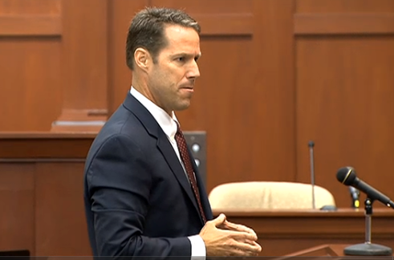
Video clip: John Guy opening from the George Zimmerman trial
Notes:
Zimmerman trial background: in Feb 2012 George Zimmerman fatally shot 17-year-old high school student Trayvon Martin in Sanford, Florida. Zimmerman was the neighborhood watch coordinator for the gated community where the shooting occurred and where Martin was temporarily staying. Martin was not armed, and Zimmerman claimed to have shot in self defense. Case sparked national outrage and protests and Zimmerman was eventually charged with second-degree murder by a special prosecutor appointed by the Governor.
Video clip: in this short clip of prosecutor John Guy’s opening statement, listen for how he provides the jury with a compelling narrative designed to show that the shooting was unjustified.
On July 13, 2014, a jury acquitted Zimmerman of second-degree murder and manslaughter.

Slide 10
Cast of characters: the defense attorney
Types
Private
Public defender
Notes:
Image: Gregory Peck as Atticus Finch in To Kill a Mockingbird.
Private: defendant has right to choose counsel if he/she can afford to pay.
Sixth Amendment: “In all criminal prosecutions, the accused shall enjoy the right . . . to have the Assistance of Counsel for his defense.”
Public defender: defendant has right to have counsel appointed if he/she cannot afford to pay in any case where the punishment could include actual imprisonment. Public defenders are publically-funded, salaried government employees.

Slide 11
Cast of characters: the defense attorney
Roles and Responsibilities
Zealously represent client by
Protecting rights
Advising client in plea negotiations
Investigating possible defenses
Forcing prosecution to prove guilt at trial
Notes:
Image: Raymond Burr as Perry Mason.
Zealous representation include just about any legitimate means of securing a favorable result for a client, constrained only by counsel’s competing responsibilities as an officer of the court.
Investigation: may include talking to potential witnesses, reviewing police reports, consulting with experts.
Presumption of innocence: sometimes called “the golden thread” running through English and American criminal law, the presumption of innocence means that everyone is presumed honest and innocent unless proved legally to the contrary.

Slide 12
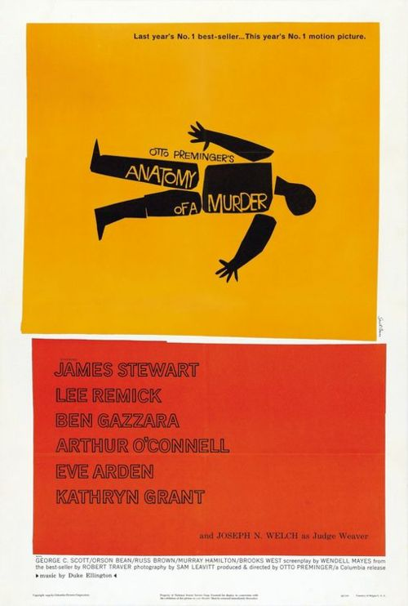
Video clip: 4 ways to defend murder
Notes:
Movie background: Anatomy of a Murder is a crime drama starring Jimmy Stewart, some think it the finest trial movie ever made. Stewart plays small-town lawyer Paul Biegler, who is retained to defend a US Army Lieutenant who has been arrested for murdering an innkeeper named Barney Quill. The Lieutenant does not deny the murder, but claims that Quill raped his wife.
Movie clip: in this scene, the defense attorney (played by Stewart) meets with the Lieutenant to discuss possible defenses. Watch how Stewart’s character walks right to the very edge of ethical representation during their conversation and be ready to discuss whether you think this is just good lawyering or whether he crosses the line into unethical conduct.
Small group discussion: is this zealous, brilliant lawyering or did Stewart cross the line into unethical conduct (witness coaching/misrepresentation)? Why?

Slide 13
Cast of characters: the judge
Preside over the case and maintain order
Rule on evidentiary disputes
Instruct the jury
Sentence criminal defendants
Notes:
Image: Judge Susan Johnson, 8th judicial district court judge.
Preside and maintain order: think of an umpire who calls “balls” and “strikes.”

Slide 14
Cast of characters: correctional officers and staff
Role and responsibilities:
Confine and rehabilitate convicted felons.
Ensure safety and security of staff and inmates.
Notes:
Image: NDOC graduation?

Slide 15
Questions?

Slide 16
Time for a break.
Up next: steps in the criminal justice system, Nevada courts, and classification of crimes.

Slide 17
Steps in the criminal justice system
Notes:
Image: unhelpful flowchart showing steps in the criminal justice system.
To better understand how the system works, think about the as being composed of three phases: the pre-trial phase, the trial phase, and the post-trial phase.

Slide 18
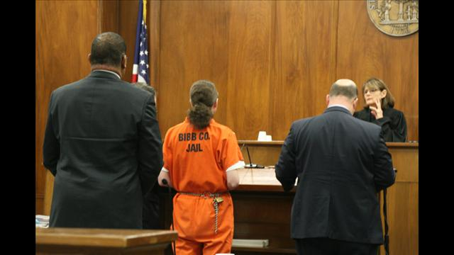
Phase 1: pre-trial
Before court
In court
Crime
Investigation
Arrest
Charges filed
Initial appearance
Arraignment
Preliminary hearing
Notes:
Charging document: criminal information (based on affidavit probable cause) or indictment (grand jury proceeding).
Initial appearance: confirm identity, discuss bail (dangerousness and flight risk factors). Generally required within 72 hours of arrest. NRS 171.178.
Arraignment: formal reading of a criminal charging document to the defendant, entry of plea of guilty/not guilty.
Preliminary hearing: mini-trial in which the prosecution must prove that there is enough evidence to require a trial (probable cause to believe that the crime was committed by the defendant).
Does the State ever bring criminal charges against inmates? (Yes) Review: who is responsible for prosecuting inmate crimes? (AG)
Discussion: how might a correctional officer or prison staff member be involved in these pre-trial steps in the criminal justice system?

Slide 19
Phase 2: trial
Jury selection
Opening statements
Prosecutor’s case
Defendant’s case
Closing arguments
Sentencing
Notes:
Applicability: NDOC employee could be called as a witness at trial, asked to testify concerning observations or prison policy.
12 jurors in criminal trial conducted by district court, verdict must be unanimous.

Slide 20
Video clip: Michelle Taylor sentencing
Notes:
Michelle Taylor sentencing background: in 2008, 13-year-old male victim visited Taylor’s residence with a younger sibling. Taylor and the children’s mother were co-workers at a casino in Jackpot, NV, near the NV-ID border. State presented evidence to establish that during the visit, the younger sibling remained in the living room watching television while the victim went into Taylor’s bedroom to play a video game with her. Instead of playing the game however, Taylor straddled the victim, removed her sweatshirt, placed the victim’s hand on her breast, and asked him to have sex with her. The victim replied that he wanted to wait until he was older before engaging in sex, got his little brother, and ran home. Taylor’s defense was that she had been drinking heavily that day and that she would never have made a sexual advance toward the victim because she is only attracted to adults. Taylor was later charged and convicted of lewdness with a minor under the age of 14 and sentenced to life in prison with the possibility of parole after 10 years.
Video clip/small group discussion: listen to the defense attorney’s argument and be ready to tell me 1) whether you think it was effective, and 2) whether the judge should have been able to exercise discretion in this case. Note video was posted by a group that opposes NV’s mandatory sentencing scheme, includes related commentary.
Issues: proportionality between offense and punishment, defense attorney’s disorganized but passionate delivery, lack of discretion in sentencing, gender as a consideration in sentencing.

Slide 21
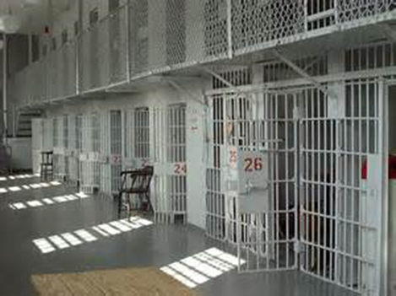
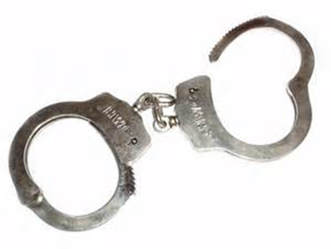
Phase 3: post-trial
Probation or incarceration
Appeals
Parole
Sentence expires
Notes:
Probation defined: court-ordered sanction that allows a convicted offender to remain in the community under the supervision of a Probation Officer. Conditions of supervision often include fines, restitution, community service, educational programs, counseling, drug tests, etc.
Appeals: offender may appeal conviction to Nevada courts and also to Federal courts, make take a decade or longer before reaching a conclusion.
Parole defined: release of a prisoner whose maximum term has not expired on condition of sustained lawful behavior monitored by Parole Officer (must have served minimum sentence and have been found
Either probation or parole may be revoked if offender violates conditions of supervised release.

Slide 22
Nevada courts
Justice Court
District Court
Intermediate Appellate Court
Supreme Court
Notes:
Image: the Regional Justice Center in downtown Las Vegas.
Justice court: small claims (money damages for $7,500 or less); parties often are not represented by an attorney; a little crazy, disorganized. Justice courts hear claims related to loss or destruction of inmate property. Also handle misdemeanor criminal cases and preliminary hearings for gross misdemeanor and felony cases.
District court: court of general jx (sue for money, sue for specific performance, sue for injunction), trial court for both civil and criminal matters. Inmates may file cases against prison staff alleging violations of their constitutional rights in district court.
Intermediate appellate court: just started this year, hears appeals from district court, tries to determine whether district court made a mistake that affected the outcome.
Supreme Court: highest state court, hears cases that have special importance because of a novel issue or wide applicability.

Slide 23
Federal Courts
District court
Court of Appeals (Ninth Circuit)
US Supreme Court
Notes:
Image: Lloyd George federal courthouse in downtown Las Vegas.
District court: court of general jurisdiction over federal causes of action, inmates may file cases against prison staff alleging violations of their constitutional rights in federal district court.

Slide 24
Classification of crimes
Parties to a crime: principals and accessories.
Felonies: punishable by death or imprisonment of 1+ years.
Class A: death or life imprisonment
Class B: one to twenty
Class C: one to five
Misdemeanors
Gross misdemeanor: punishable by imprisonment not to exceed 1 year.
Everything else is a ordinary misdemeanor (no infractions in NV)
Notes:
Principal to a crime: anyone who directly commits an act constituting the offends or assists in its commission whether present or absent. NRS 195.020.
Accessories to a crime: after commission of a felony, anyone who destroys evidence or harbors offender with intent that offender avoid arrest. Excludes spouses and domestic partners. NRS 195.030.

Slide 25
Theories of punishment
Deterrence
Retribution
Rehabilitation
Notes:
Deterrence: seeks to discourage offender from committing future crimes (incapacitation), discourage others who see consequences of offending.
Retribution: seeks to punish offenders for past crimes regardless of whether punishment is beneficial for society; fairness requires that offender must endure punishment to nullify unfair advantage gained by breaking the law; punishment is recognition of the offender’s status as a moral being (demand your right to be punished!).
Rehabilitation: attempts to correct problematic behavior or take away offender’s desire to engage in criminal conduct (e.g., substance abuse problems).

Slide 26
Questions?

Slide 27
It’s time for another break.
Notes:
Questions?

